Slide 1
APUSH Review: The 7 Years’ (French and Indian) War As A Turning Point
Everything You Need To Know ABOUT The 7 Years’ War As a turning Point to succeed in apush

Slide 2
The 7 Years’ War
What was it?
  War between Britain and colonists and the French and many Native tribes
When was it?
  1754 - 1763
Who won the war?
  The British, France was removed from North America
Victory for the colonists??????
  That’s why it’s a turning point!

Slide 3
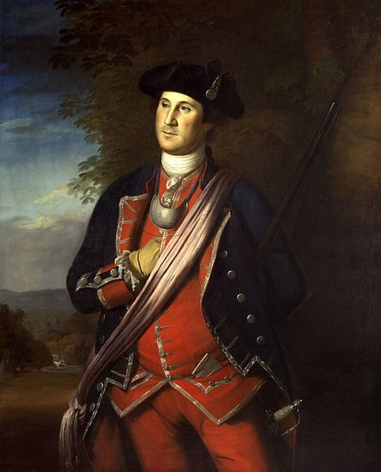
Key Ideas Before The War
British colonists sought to expand into the Ohio River Valley
  George Washington
Albany Plan of Union:
  Benjamin Franklin’s Plan to unite the colonies
  Rejected by colonial legislatures
Salutary Neglect!
  Britain’s lax policy towards the colonies
  Britain left the colonies alone as long as they were profitable

Slide 4
1763: An Important Year
When it comes to 1763, think PEEP!
Pontiac’s Rebellion:
  Native American rebellion in Ohio and Michigan areas against British colonial expansion
End of the 7 Years War:
  Britain defeats the French, gains land to the Mississippi River
End of Salutary Neglect:
  Britain is in MASSIVE war DEBT, takes a more hands on approach with the colonies
Proclamation Line of 1763:
  Forbade colonial expansion beyond the Appalachian Mountains
  Infuriated colonists

Slide 5
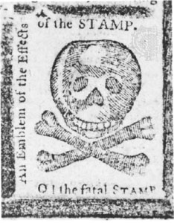
Key Ideas AFTER The War
The relationship between Britain and the colonies drastically changed
  Britain is in DEBT! Ends salutary neglect, colonists resist the new British Acts
  Proclamation Line -> Some colonists ignored
  Stamp Act -> Stamp Act Congress (boycott, tar and feathering)
  Tea Act -> Boston Tea Party
  Intolerable Acts -> First Continental Congress
Important note - until 1776, most colonists did NOT want independence, rather, they longed for the days of salutary neglect

Slide 6
So…… How Was The War A Turning Point?
Changes:
  End of Salutary Neglect! (THIS IS EVERYTHING!)
  Emergence of colonial unity AGAINST the British
    Stamp Act Congress
  Treatment of American soldiers - could only be promoted so far
Continuities:
  Colonists viewed themselves as British
  Most colonists did NOT want independence (until 1776)
Possible Synthesis Point:
  Connecting the 7 Years’ War to the American Revolution
  Social, Economic, and Political categories

Slide 7
Test Tips
Multiple-Choice and Short Answer
  Impacts of the war on colonists
  Stamp Act, Proclamation Line, etc. as an excerpt
  Comparing colonial responses to the British government (loyalists and patriots)
Essays:
  Analyzing the war as a turning point in colonial history

Slide 8
Thanks For Watching!
Check out my playlist on Turning Points
Best of luck in May!

