Slide 1
APUSH Review: The Mexican-American War As A Turning Point
Everything You Need To Know About The Mexican-American War As A Turning Point To Succeed In APUSH

Slide 2
The Mexican-American War
What was it?
  War between the US and Mexico - started over Texas border dispute
When was it?
  1846 - 1848
Who won the war?
  US - gained the Mexican Cession
Issues?
  SLAVERY!

Slide 3
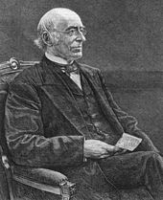
Key Ideas Before The War
Prior US expansion led to debates over slavery - LA Purchase -> Missouri Compromise
Both the North and South sought to have an equal number of slave and free states
Americans began moving into Texas in large numbers in the 1820s
TX declared independence in 1836
Manifest Destiny swept the nation in the 1840s:
  John O’Sullivan
  Election of 1844
Rise of the abolitionist movement:
  William Lloyd Garrison’s The Liberator
  Nat Turner’s Rebellion

Slide 4
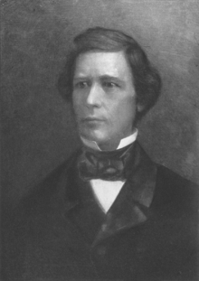
Key Ideas After The War
Manifest Destiny is complete
Fate of territories?
  Enormous debates
    Wilmot Proviso
    Compromise of 1850
Gadsden Purchase - purpose was for a transcontinental RR in the South ->

Slide 5
Key Ideas After The War
Kansas-Nebraska Act - overturned MO Compromise
  North is FURIOUS! Slavery issue
“Bleeding Kansas” - John Brown Part I
Emergence of the Republican Party
  Free Soil Platform - stop the expansion of slavery

Slide 6
So…… How Was The War A Turning Point?
Changes:
  Growth of abolitionist movement after - Fugitive Slave Act
  Increased sectional tensions - Bleeding Kansas, Caning of Charles Sumner
  Popular Sovereignty
Continuities:
  Restrictions and tightening of African American rights, especially the South
  Spread of slavery out west (LA Purchase, and now Mexican Cession)
  Different labor systems - slavery entrenched, north free labor
Possible Synthesis Point:
  Connecting the Mexican-American War to the Civil War
  Comparing debates over Mexican Cession to debates over expansion after the Spanish-American War

Slide 7
Test Tips
Multiple-Choice and Short Answer:
  Impacts of the war on slavery
  Wilmot Proviso or opposition to the war as an excerpt
  Manifest Destiny
Essays:
  The war as a turning point for slavery debates
  Evaluating how Manifest Destiny led to debates over slavery
  Comparing and Contrasting arguments for and against expansion

Slide 8
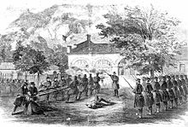
Thanks For Watching!
Check out my playlist on Turning Points
Best of luck in May!

