Slide 1
APUSH Review: The Progressive Era As A Turning Point
Shoutout to Moffi in Florida,
Everything You Need To Know About the progressive era as a turning point to succeed in apush

Slide 2
The Progressive Era
What was it?
Period of increased government reform (local, state, and federal)
Saw increased democracy (17th and 19th amendments, initiative, referendum, and recall)
Increased government involvement in the economy (FDA, Hepburn Act, Clayton Anti-trust Act)
When was it?
1890s - 1920
Who were “Progressives”?
Journalists, middle and upper class, women, urban residents
Individuals that sought to use the government to improve problems of society

Slide 3
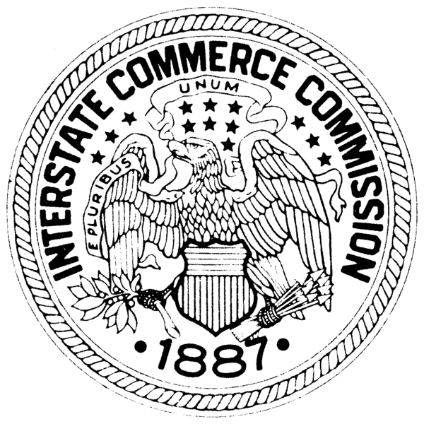
The US Before The Progressive Era
Industrialization:
Growth of businesses -> trusts, monopolies, and other forms of consolidating power (Gilded Age)
Carnegie Steel, Rockefeller Oil
Led to emergence of unions and calls for business reform (Interstate Commerce Act - 1887, Sherman Anti-trust - 1890)
Urbanization:
Growth of large cities (NY, Chicago)
Tenement housing for immigrants and poor
“New” Immigrants predominantly lived in cities
Rise of nativism (again) - APA

Slide 4
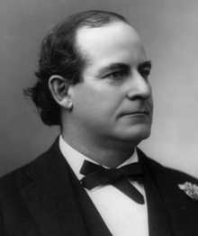
The US Before The Progressive Era
Politics:
State and local levels:
Political machines - Tammany Hall
Provided services to immigrants and poor in exchange for support
National level:
Senators were elected by state legislatures - calls for direct elections (Populist idea)
1/2 the population could not vote (women)
Economics:
No federal income tax - calls for graduated income tax (Populist idea)
Populists advocated government ownership of RRs, telegraphs, and telephones

Slide 5
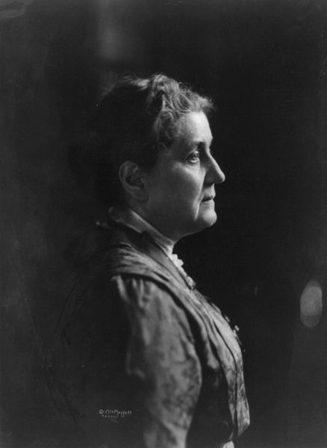
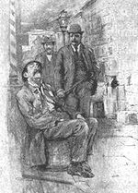
Major Social Progressive Era Milestones
Muckrakers - authors that exposed societal ills
Upton Sinclair - The Jungle - led to Pure Food and Drug Act
Jacob Riis - How The Other Half Lives - many tenements in NYC were torn down
Jane Addams and the Hull House (Chicago)
Aided women, children, and immigrants
Inspired other settlement houses throughout the country
18th Amendment - Prohibition
Alcohol is illegal
Fulfillment of Temperance Movement goals (early-mid 19th century)

Slide 6
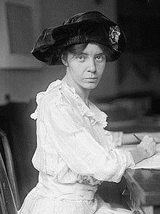
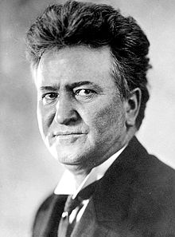
Major Political Progressive Era Milestones
State and Local levels:
Initiative, Referendum, recall - Wisconsin (LaFollette)
Secret Ballot (Populist Idea)
National Level:
17th amendment - direct election of senators
19th amendment - women’s suffrage
Clayton Antitrust Act - strengthened the Sherman Antirust Act, exempted labor unions from prosecution
Conservation:
Newlands Reclamation Act - funded irrigation projects out west
Antiquities Act - president can set aside land to create monuments

Slide 7
Major Economic Progressive Era Milestones
Northern Securities Decision - broke up JP Morgan’s company
“Trust Busting” - TR and Taft broke up many trusts
Underwood Tariff - Under the Democrat Wilson
16th Amendment - graduated income tax
Federal Reserve Act
Created the Federal Reserve - still around
Central banking system, prints US $
Increase and decrease the supply of $

Slide 8
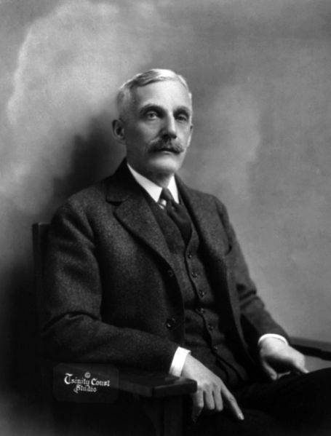
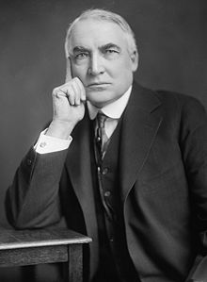
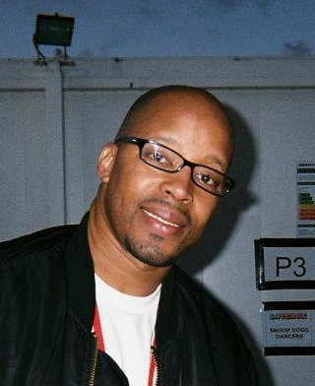
The US After The Progressive Era
Election of 1920:
Warren G……. Harding campaigns on a “Return to Normalcy”
Called for less government involvement in the economy (back to laissez-faire)
Return to isolationism/neutrality (rejection of the Treaty of Versailles and League of Nations)
Treasury Secretary Andrew Mellon (1920s)
Advocated lower taxes for wealthy - similar to Ronald Reagan’s “trickle-down” economics
21st Amendment (1933) - reversed the 18th, prohibition is over
Quota Acts of the 1920s:
Reversed unlimited immigration to US
Severely restricted immigration, especially “New” immigrants

Slide 9
So….. How Was It A Turning point?
Supports idea of turning point (Change):
Changes to democracy (17th, 19th amendments), initiative, referendum, recall, and secret ballot
Changes for poor, immigrants, and consumers (Hull House, elimination of some tenements, Pure Food and Drug Act)
Increased government involvement in the economy (Hepburn Act, Clayton Antitrust Act, Federal Reserve Act, “Trustbusting”)
Does NOT support idea of turning point (Continuity):
African Americans still faced discrimination, segregation, and other obstacles (literacy tests, poll taxes)
Prohibition was overturned in the 1930s - need for revenue
Government economic regulation decreased in the 1920s (Return to Normalcy)

Slide 10
Test Tips
Multiple-Choice and Short Answer:
Characteristics of Progressives and their goals
Excerpt from Jacob Riis, Jane Addams, or Upton Sinclair
Progressive Amendments
Ways democracy increased
Essays:
Progressive Era as a Turning point
Comparing the Progressive Era with Populists/New Deal/Great Society

Slide 11
Thanks For Watching!
Check out my playlist that covers Turning Points
Best of luck in May!

