Slide 1
APUSH Review: The Spanish-American War As A Turning Point

Slide 2
The Spanish-American War
What was it?
  War between Spain and America, from April - August, 1898
Where did fighting occur?
  Caribbean (Cuba) and Asia (Philippines)
What were causes of the war?
  De Lome letter, Yellow Journalism, USS Maine
Who won the war?
  US
What did the US gain?
  Philippines, Cuba, Guam, and Puerto Rico

Slide 3
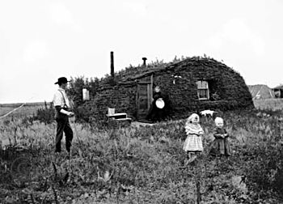
The US Before The War
Manifest Destiny was complete in the 1850s
  After the Civil War, the US government encouraged westward settlement
    Homestead Act, subsidies to RRs
In the 1890s, the frontier was perceived to be “closed”
1890 - The Influence of Sea Power Upon History
  Alfred T. Mahan
  Argued that a naval power was important for world dominance

Slide 4

Foreign Relations Before The War
Hey Joey and Ross, want to go to Japan with me?
Monroe Doctrine (1823):
  Europe could not recolonize any areas of Latin America
  US would stay out of European affairs (continuation of Washington’s Farewell Address)
Treaty of Wanhia (1844):
  Caleb Cushing - first treaty with China
Treaty of Kanagawa (1854):
  Matthew Perry and the “opening” of Japan
Up until the 1890s, most US interactions with other countries were for economic reasons, not to acquire territory

Slide 5
Foreign Relations Before The War
McKinley Tariff - 1890
  Raised prices on sugar imports from Hawaii
  Many farmers in Hawaii were Americans that called for annexation
  Grover Cleveland blocked annexation after a revolt in 1893
    Hawaii would not be annexed until 1898…..
    The same year as the Spanish-American War

Slide 6
Foreign Relations After The War
Independence for the acquired territories?
  McKinley did believed the Philippines were not ready for independence
  He advocated Christianizing and civilizing Filipinos
Cuba:
  Platt Amendment - US could intervene in Cuba to restore order if necessary, US must approve all Cuban treaties, US gained Guantanamo Bay (still have)

Slide 7
Land Acquisition And National Identity
With the exception of a few Pacific islands, land acquisition was limited to North America
The cultures, governments, and languages of these territories were vastly different from America
  Should these territories be incorporated with full rights of Americans?

Slide 8
The Supreme Court And The Territories
Does the Constitution apply to these newly acquired territories?
  Does the Constitution follow the flag?
  Insular Cases (1901) - the Constitution does not necessarily apply to the newly acquired territories
    Even if they are citizens (Puerto Rico), they are not entitled to the same rights as Americans

Slide 9
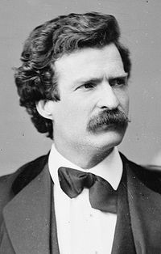
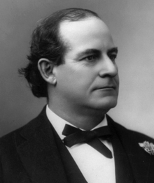
Anti-Imperialists vs. Imperialists
Anti-Imperialist League:
  Made up of Carnegie, Mark Twain, William Jennings Bryan, presidents of major colleges, and others
  Argued against the land acquisitions
  Believed it violated self-determination and the ideals of the Declaration of Independence
  US could become involved in fighting in Asia (protracted nationalist insurrection in the Philippines - Emilio Aguinaldo)
Supporters of Acquisition:
  William McKinley, Rudyard Kipling
  Argued it was America’s patriotic duty to civilize other regions; land would provide economic opportunities for America

Slide 10
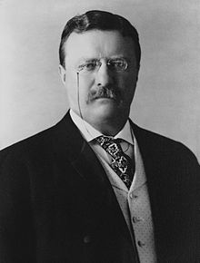
US In Latin America - Early 20th Century
"Chronic wrongdoing . . . may in America, as elsewhere, ultimately require intervention by some civilized nation, and in the Western Hemisphere the adherence of the United States to the Monroe Doctrine may force the United States, however reluctantly, in flagrant cases of such wrongdoing or impotence, to the exercise of an international police power."
Roosevelt Corollary to the Monroe Doctrine:
  T. Roosevelt feared European intervention in Latin America - some nations were in debt to Europe
  US could intervene in Latin America to preserve order
  Essentially, the Doctrine allowed the US to become a Police Power
  TR, Taft, and Wilson sent troops to Latin American countries and invoked the Roosevelt Corollary
Panama Canal - US encouraged Panama to start a revolution in Colombia
  Hay-Bunau-Varilla Treaty - created the Panama Canal - US would control until 1999

Slide 11
So…. How Was The War A Turning Point?
Prior to the war:
  US focused on promoting westward settlement until 1890s
  Most interaction with foreign countries was for economic purposes - US did not acquire overseas territory in large numbers
After the war:
  The focus shifted from westward settlement to overseas land acquisition (“closing” of the frontier, The Influence of Sea Power Upon History
  US gained significant territory - did not grant statehood to territories
  Economic motives was no longer the only factor
  Debates between Anti-Imperialists and Imperialists

Slide 12
Test Tips
Multiple-Choice and Short Answer:
  Reasons for and against US expansion overseas (SCREAMS Short Answer to me)
Essays:
  Analyzing the war as a turning point
  Comparing and contrasting arguments for and against expansion

Slide 13
Thanks For Watching!
Check out the playlist on Turning Points
Best of luck in May!

