Slide 1
APUSH Review: Breaking Down A Spanish Colonization Illustration
Everything You Need To Know About An Illustration about Spanish Colonization To Succeed In APUSH
Want more document analysis? Take my FREE course at APUSHREVIEW.COM

Slide 2
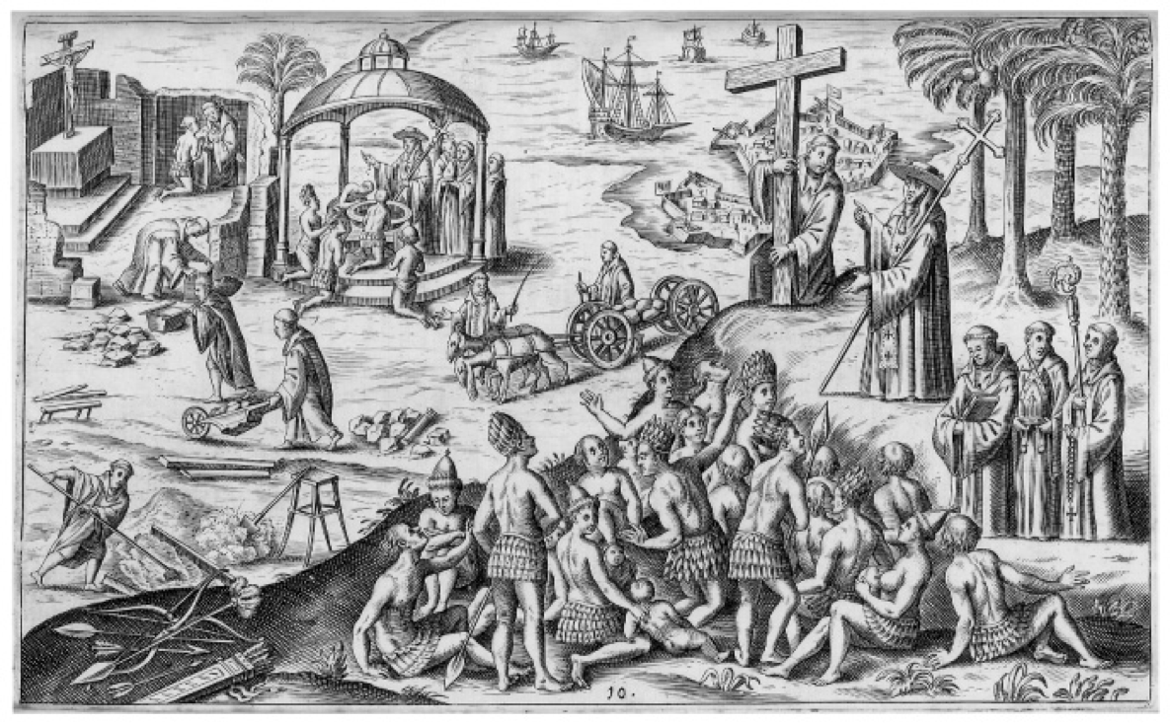
Spanish Colonization, 1621

Slide 3
HIPP It Up!
Historical Context?
16th Century - Conquistadors and Encomiendas
Conversion of Natives, intermarrying with Spanish
Intended Audience?
Spanish in Europe, other Europeans
Point of View?
Positive towards Spanish Colonization - working in harmony
Spanish are “saving” Natives
Purpose?
To portray the benefits of Spanish Colonization

Slide 4
Thanks For Watching!
Best of luck in May!
Answer a Short Answer Question based on this document in my free course!

