Slide 1
APUSH Review: Breaking Down The Proclamation Line of 1763
Everything You Need To Know About The Proclamation Line of 1763 To Succeed In APUSH
Want more document analysis? Take my FREE course at APUSHREVIEW.COM

Slide 2
Quick Recap: 1763
Think PEEP!
Pontiac’s Rebellion
End of 7 Years’ War
End of Salutary Neglect
Proclamation Line of 1763

Slide 3
Proclamation Line
And We do hereby strictly forbid, on Pain of our Displeasure, all our loving Subjects from making any Purchases or Settlements whatever…… without our especial leave and Licence for that Purpose first obtained.
And We do further strictly enjoin and require all Persons whatever who have either wilfully or inadvertently seated themselves upon any Lands ……. to remove themselves from such Settlements.

Slide 4
Document Analysis Questions
What was the reaction to this document?
Anger, disobedience
What was the cause of this document?
Conflict with Natives (Pontiac’s Rebellion)
What were the effects of this document?
Distrust between colonists and British

Slide 5
HIPP IT UP!
Historical Context?
End of 7 Years’ War, colonists sought to expand west
France was removed from North America
Intended Audience?
British colonists
Point of View?
Negative towards expansion
Purpose?
To keep colonists from expanding west/avoid conflicts

Slide 6
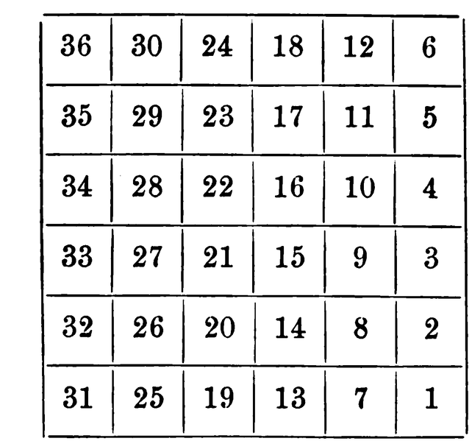
That’s It!
Thanks for watching!
Best of luck!

