Slide 1
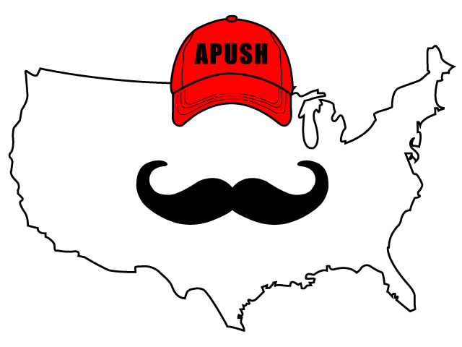
APUSH Review: Breaking Down A Political Cartoon About Ratifying The Constitution
Everything You Need To Know To Succeed In APUSH

Slide 2
1788

Slide 3
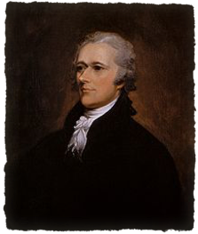
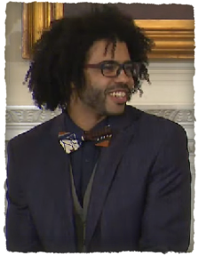
Document Analysis Questions
What is the meaning of the cartoon?
The Constitution requires the support of ALL states
Who would support this cartoon?
Federalists, those that supported a strong central government
Who would oppose this cartoon?
Anti-Federalists, those that supported a weaker central government

Slide 4
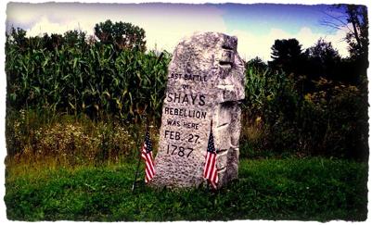
Document Analysis Questions
Why did people support a stronger government under the Constitution?
Articles were weak - Shays’ Rebellion showed the ineffectiveness of the Articles
What, ultimately, led to the ratification of the Constitution?
The promise to add the Bill of Rights (1st 10 Amendments)
Satisfied Anti-Federalist fears of a strong central government

Slide 5
HIPP Analysis
Historical Context?
Debates over ratification of the Constitution - Federalists v. Anti-Federalists
Intended Audience?
North Carolina and Rhode Island
Purpose?
To gain support for ratification in those states
Point of View?
Positive towards ratification and a stronger central government

Slide 6
That’s It!
Thanks for watching!
Best of luck this year!

