Slide 1
APUSH Review: Comparing And Contrasting The 1st And 2nd Party Systems
Shout Out Time: Dr. Copeland’s Class in MN, Mrs. Hegedorn’s Class in Fairport, and Mr. Mallaber’s class in Rochester!
Everything You Need To Know About The First And Second Party Systems To Succeed In APUSH

Slide 2
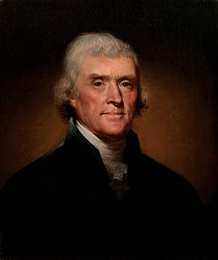
The First Party System
When did it begin?
1790s
What were the first two parties?
Federalists, Democratic-Republicans
Why did they develop?
Differences over:
Interpretation of the Constitution, federal vs. state power, foreign policy, economic policy
Viva La France!

Slide 3
Topic | Federalist View | Democratic-Republican View
National Bank (Hamilton’s Financial Plan) | Pro-bank and Hamilton’s plan; believed it would help the economy | Anti-bank; feared it gave government too much power
Foreign Policy | Pro-British & Jay’s Treaty (trade); Neutrality in European Wars | Pro-French (Saratoga, Declaration of Independence); wanted US to side with France
Constitution Interpretation | Loose - broad view | Strict - narrow view
Federal v. State Powers | Stronger federal government | Weaker federal government (States’ Rights)

Slide 4
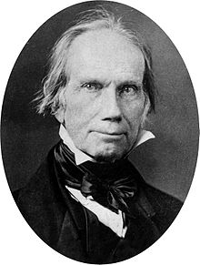
The Second Party System
When did it begin?
1830s
What were the two parties?
Democrats and Whigs
Why did they develop?
Differences over:
Tariffs, powers of the federal government, national bank (BUS), internal improvements
The Bank is trying to kill me, but I will kill it!

Slide 5
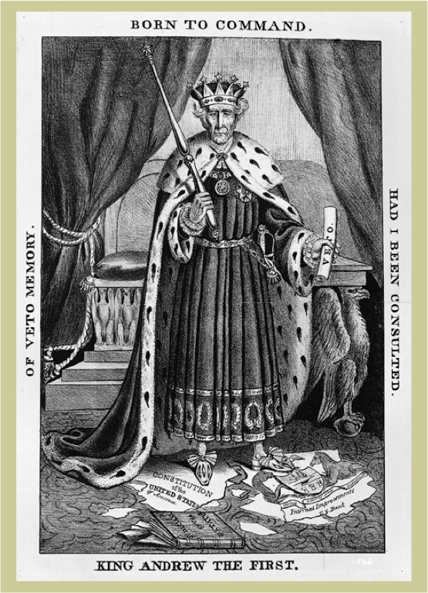
Topic | Whig View | Democrat View
Tariffs | Favored tariffs - would fund internal improvements | Opposed tariffs - raised cost of goods
National Bank | Favored the 2nd Bank, as well as the 3rd Bank (vetoed by Jackson) | Weary of National Bank - too much power for wealthy
Federally Funded Internal Improvements | Favored - connect the country. Advocated funding for intrastate | Opposed - federal $ should not go towards intrastate (Maysville)
American System | Pro - comprised of 3 parts above | Against - Think Andrew Jackson
Between tariffs, national bank, and federally funded internal improvements, rank in order of significance in the creation of the Second Party System. Why did you choose what you did?
2
1
3

Slide 6
So….. What Is Similar?
Federalists and Whigs favored:
Stronger central government
National Banks
Tariffs
Democratic-Republicans and Democrats were against:
National Banks
Tariffs
State vs. Federal government power

Slide 7
So….. What Is Different?
Foreign policy was not significant in the Second Party System as it was the First
Internal Improvements were a major focus of the 2nd Party System

Slide 8
Short Answer Question
Good luck this year. You are brilliant!
a. Briefly explain how ONE of the following was most significant in the formation of political parties in the early-19th century. (Whigs and Democrats)
• National Bank (BUS)
• Tariffs
• Federally funded internal improvements
b. Provide ONE piece of historical evidence that supports your choice in part a.
c. Briefly explain why one of the other options is not as significant in the formation of political parties in the early-19th century. (Whigs and Democrats)

