Slide 1
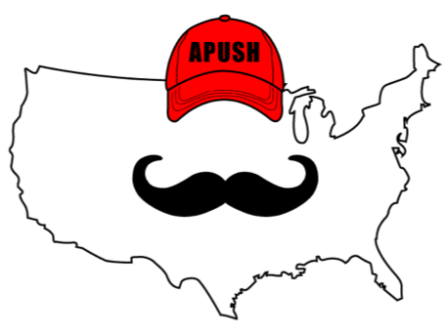
APUSH Review: Reconstruction
Everything You Need To Know About Reconstruction To Succeed In APUSH

Slide 2
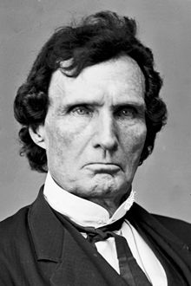
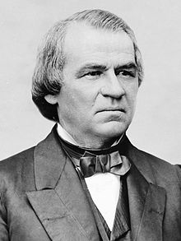
What Is Reconstruction?
Attempting to achieve national unification after the Civil War
A major question: who would control Reconstruction, Congress or the President?

Slide 3
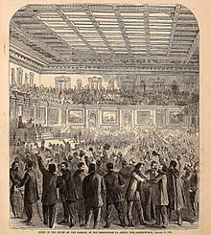
Reconstruction Amendments
13 - abolished slavery
14 - granted citizenship and equal protection
15 - Adult male suffrage
Impact of the 14th and 15th amendments?
  “The women’s rights movement was both emboldened and divided.”
  Some argued for universal male suffrage first - Lucy Stone
  Others argued for female suffrage at the same time - Stanton and Susan B. Anthony

Slide 4
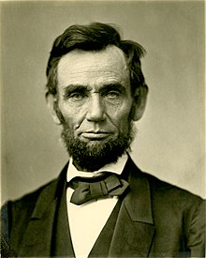
Presidential Reconstruction (1865 - 1867)
Lincoln’s 10% Plan:
  Southern states could be readmitted if 10% of voters in 1860 pledged loyalty
  Many in Congress felt it was too lenient
Johnson’s Plan
  Wealthy plantation owners could ask for a pardon

Slide 5
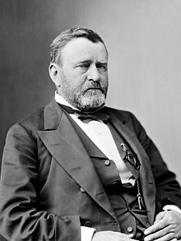
Radical Reconstruction (1867 - 1877)
Response to Southerners actions such as
  Alexander Stevens
  Black Codes - harsh laws that regulated behavior of African Americans
Reconstruction Act of 1867
  Divided the South into 5 military districts
  Response to Southerners such as Alexander Stevens

Slide 6
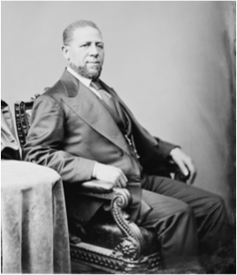
Radical Republicans
Sought to “change the balance of power between Congress and the presidency” and “reorder race relations in the South”
  Impeachment of Andrew Johnson
    Removal was one vote shy
  Many of Johnson’s vetoes were overridden by Congress
    Civil Rights Act of 1866 - protection for citizens
  Reorder of race relations:
    Several African Americans held political office
      Hiram Revels - Senator from MS

Slide 7
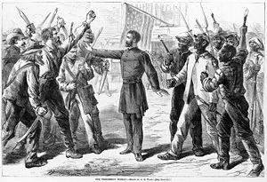
Short-Term Successes of Reconstruction
Political and leadership opportunities for former slaves
Freedmen’s Bureau
  Provided food, medicine, clothing, and education to former slaves
  Promised “40 acres and a mule”, but rarely occurred

Slide 8
Land Ownership and Sharecropping
Plantation owners still owned a majority of land
  Former slaves had difficulty in acquiring land
Sharecropping:
  Former slaves and poor whites worked on farms and exchanged labor for land and housing
  1/2 of crops were given to land owner
  If cotton prices fell, perpetual debt was common for sharecroppers

Slide 9
Why Did Reconstruction Fail?
W
North’s waning resolve
  By 1877, economic issues (Panic of 1873) and political issues (Election of 1876) led to many in the North to want to move on from Reconstruction
Compromise of 1877:
  Hayes (Republican) wins the presidency, military is withdrawn from the South
Southern resistance to Reconstruction:
  Jim Crow laws, KKK, Black Codes
A
N
I
N
G

Slide 10
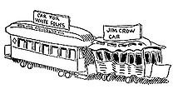
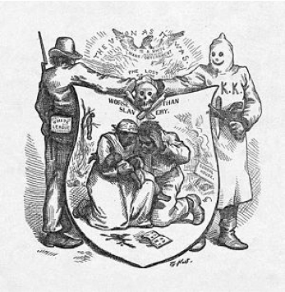
Southern Resistance to 14th and 15th Amendments
4 major ways (Great Short Answer Question)
Segregation:
  Jim Crow laws allowed for inferior facilities
Violence:
  KKK, lynchings

Slide 11
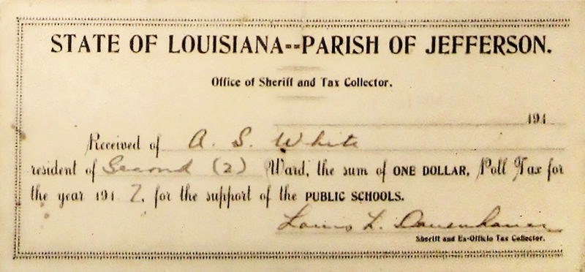
Southern Resistance to 14th and 15th Amendments
Supreme Court Decisions:
  Civil Rights Cases (1883) - individuals and private businesses could discriminate
  Plessy v. Ferguson - upheld the Constitutionality of Jim Crow laws; “Separate but equal”
Local political tactics:
  Poll taxes
  Literacy tests
  Grandfather clause

Slide 12
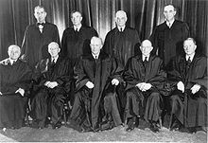
14th and 15th Amendments in the 20th Century
These amendments will be used to uphold civil rights
Brown v. Board - Separate but Equal is NOT constitutional

Slide 13
Test Tips
Multiple-Choice and Short Answer
  Remember the North’s Waning resolve and desire to change balance of power between Congress and President
  Methods used by the South to resist 14th and 15th amendments
Essays:
  Change and Continuity over time for African Americans (1860 - 1877)
  Effectiveness of Reconstruction

Slide 14
Thanks For Watching!
Best of luck in May!

