Slide 1
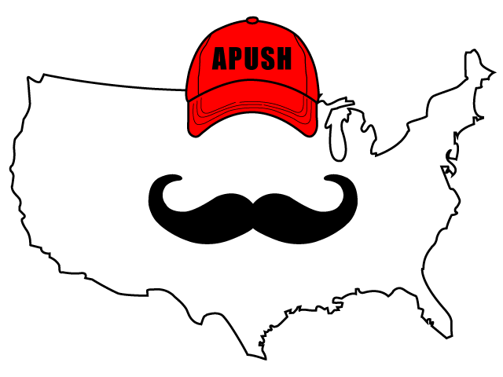
APUSH Review: Video #1: Native Americans PRIOR To European Contact (Key Concept 1.1, I, A-D)
Everything You Need To Know About Europeans Prior To European Contact To Succeed In APUSH

Slide 2
Natives In Present-Day America: American Southwest
Maize cultivation - growing corn
  Spread from Mexico to Southwestern US
Societies developed irrigation systems (Pueblos in Rio Grande)
How did it transform societies?
  Less emphasis on hunting and gathering
  Increase in population
  Establishment of permanent villages with socially diverse societies
    Tenochtitlan - 250,000 people, social classes

Slide 3
Natives In Present-Day America: Great Plains and Great Basin
Great Basin:
  Arid (dry)
Great Plains:
  Grasslands (western plains)
In both areas, Natives were mostly mobile
  Bison and sheep (Great Basin)
With the introduction of the horse, life in these two areas was drastically altered
  Natives with horses became stronger militarily
  Bison hinting became easier

Slide 4
Natives In Present-Day America: Northeast
Many societies were a mix of hunting and gathering and agriculture and developed permanent villages
Iroquois (Northeast - present-day NY and PA)
  Adapted to their environment
    Burned forests to hunt and grow crops
    Villages were built around maize
Iroquois were a matriarchal society:
  Power was based on female authority
  Women were instrumental in decision-making
  Women would tend to crops and oversaw community affairs while men hunted

Slide 5
Natives In Present-Day America: Mississippi River Valley
Cahokia Indians - near present-day St. Louis
  Around 30,000 people
  Built giant mounds
  Largest settled community until NY and Philadelphia in 1800

Slide 6
Natives In Present-Day America: Atlantic Seaboard
Algonquians - New England and East Coast
Would often live in villages of a few hundred people
Survived by:
  Hunting and fishing
  Growing corn, beans, and squash

Slide 7
Natives In Present-Day America: Northwest and Present-Day California
Roughly 300,000 natives lived in California prior to arrival of Europeans
  Most societies were based on hunting, gathering, and foraging
    Gather nuts, fish, and hunted
  Societies tended to be ruled by wealthy families
  Resources of the ocean helped support life
Chinooks:
  Advanced warrior traditions
  Used advanced fighting techniques
  Lived in longhouses which could house many families

Slide 8
Quick Recap
What is maize?
  Where did it originate?
What was life like for Natives in different regions of the present-day US?

Slide 9
See You Back Here For Video #2: European Exploration And The Columbian Exchange
Thanks for watching
Best of luck on your tests

