Slide 1


APUSH Review: Video #10: Slavery In The British Colonies And Slave Resistance (Key Concept 2.2, II, A-C)
Everything You Need To Know About Slavery In The British Colonies And Slave Resistance To Succeed In APUSH
Shoutout To Mr. Keating’s Class At Fountain Hills High School. Thanks For The Support!
www.APUSHReview.com

Slide 2

Why Did ALL The British Colonies Engage In Slavery?
Large amounts of land:
  Laborers to work
European demand for colonial goods:
  Especially Tobacco
Shortage of indentured servants:
  Post-Bacon’s Rebellion (1676)
  Many indentured servants refused to work in harsh conditions of the deep South and West Indies
Great Short Answer Question…. Or Essay About The Growth Of Slavery….

Slide 3
Where Was Slavery Found In The British Colonies?
New England:
  Small New England farms
Port Cities:
  North AND South
Plantations in the Chesapeake and the South
  What two colonies were the Chesapeake?
    MD and VA
Most African slaves were sent to the West Indies

Slide 4
Effects Of An Increase Of Slavery
Emergence of a strict, racial system
Prohibition of interracial relationships
  Contrast with the Spanish colonies
Slavery was based on mother’s status
  If the mother was a slave, the child would be, regardless of the father

Slide 5
Slave Resistance
Overt methods:
  Rebellion
    Stono (1739) - slaves killed whites and tried to flee to Spanish Florida
      Harsher slave laws and restrictions emerged
Covert methods:
  Breaking tools, running away, working slowly, faking illness

Slide 6
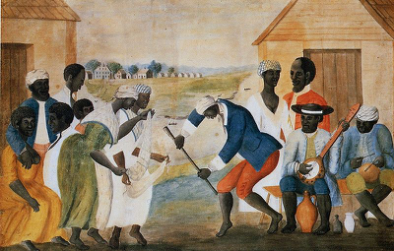
How Did Africans Preserve Some Autonomy?
Family structures:
  Surrogate families for slaves that were sold
Culture:
  Language and music
Religion:
  Combined elements of African religions with Christianity

Slide 7
Quick Recap
Reasons for the growth of slavery/participation in Slave Trade
Where did slavery occur in British colonies?
How did slaves overtly resist their situation?
How did slaves covertly resist their situation?
How did Africans preserve some forms of autonomy?
That’s it for period 2!

Slide 8
See You Back Here For Video #11: The 7 Years’ War (French And Indian) And Its Impact
Thanks for watching
Best of luck!

