Slide 1
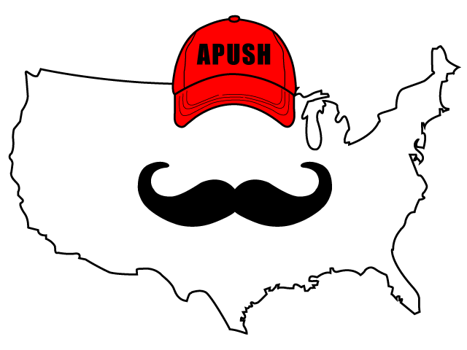
APUSH Review: Video #11: The 7 Years’ War (French and Indian), And Its Impacts (Key Concept 3.1, I, A-C)
Everything You Need To Know About The 7 Years’ War And Its Impacts To Succeed In APUSH
www.APUSHReview.com

Slide 2
Key Ideas Before The War (Historical Context)
Rivalry between Britain and France increased in the mid-18th century
  British colonists sought to expand
    George Washington challenged French expansion in western PA
  Most Natives, except for Iroquois, sided with French
Britain practiced Salutary Neglect
  Left the colonies alone as long as they were profitable

Slide 3
The War
Lasted from 1754 - 1763
Britain forced colonists to enlist and provide shelter for soldiers
Britain defeated the French
Peace of Paris, 1763:
  Britain gained all French land east of the Mississippi River, except for New Orleans
    French gave New Orleans and land west of MS to Spanish

Slide 4

Impacts Of The War
Britain is in MAJOR debt from the war
  Seek to end salutary neglect, raise revenue, and consolidate control
We’re Broke!

Slide 5
1763: An Important Year
Pontiac’s Rebellion:
  Native American rebellion in Ohio Valley to resist British encroachment
  As a result of the rebellion, Britain issues the…..
Proclamation Line of 1763:
  Forbid expansion beyond Appalachian Mountains
  Colonists were upset, ignored the order
P ontiac’s Rebellion
E nd of 7 Years’ War
E nd of Salutary Neglect
Proclamation Line of 1763

Slide 6
Quick Recap
Salutary Neglect
Most Natives sided with French
Britain gains massive amounts of land after war
  But is in MAJOR debt
    Hope to gain control over colonies
    And end Salutary Neglect
Importance of 1763
PEEP!

Slide 7
See You Back Here For Video #12: Events Leading To The American Revolution
Thanks for watching
Best of luck!

