Slide 1

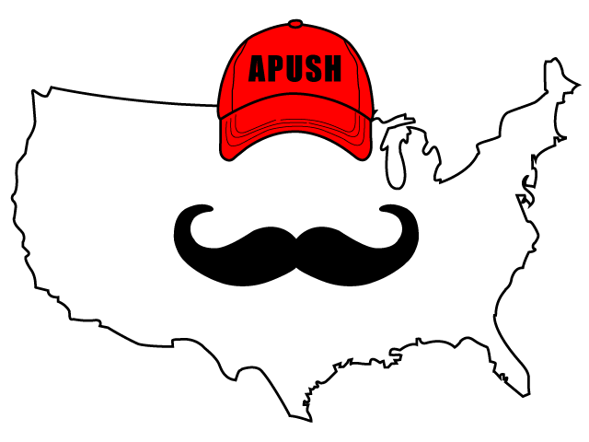
APUSH Review: Video #13: The American Revolution And Its Impacts (Key Concepts 3.1, II, D-E, 3.2, I, A, 3.2, I, C-E)
Shoutout to Mr. Robertson’s class at Steinbrenner High School. Best of luck!
Everything You Need To Know About The American Revolution To Succeed In APUSH
www.APUSHReview.com

Slide 2

Events Before The War (Historical Context)
P ontiac’s Rebellion
E nd of 7 Years’ War
E nd of Salutary Neglect
P roclamation Line of 1763
Britain ended salutary neglect in 1763
  Think PEEP!
British imposition of taxes
  Stamp, Tea, Townshend, etc.
Olive Branch Petition (1775)
  2nd Continental Congress hoped to avoid full-scale war, KG3 said no!
T-Paine’s Common Sense

Slide 3
Mobilization For The War
Patriots - those that supported independence
Loyalists - those that were loyal to England
  Roughly 20% of population
Men and women provided financial and material support to the Patriot movement
  Homespun Movement
  Women soldiers - Molly Pitcher

Slide 4
Obstacles To Victory
Loyalist opposition:
  Roughly 20%, higher in some areas
Great Britain’s military and economic advantages:
  Strongest military in the world, much more $ than the Americans

Slide 5
Why Did The Colonists Win?
Actions of colonial militias and Continental Army:
  Actions in key battles - Lexington and Concord, Bunker Hill
Washington’s leadership:
  Charismatic, resilient, revered
  Captured Hessians
Colonists’ ideological commitment:
  Belief in republic government (Enlightenment, T-Paine)
Assistance from European allies:
  Particularly French aid after the Battle of Saratoga (1777)

Slide 6
Changes To America After The War
Enlightenment helped influence individual talent over hereditary privilege
  Primogeniture was outlawed
    Eldest son inherits most, if not all, of property
Religion helped Americans see themselves as blessed with liberty

Slide 7
Push For Equality During And After The War
Some individuals called for the abolition of slavery
  Pennsylvania’s Gradual Abolition Law (1780):
    Prohibited importation of slaves into PA
    ALL children born in PA would be free, regardless if their parents were slaves
    Model for other states to follow
Increased calls for greater political democracy:
  Abigail Adams’ “Remember the Ladies”
  Judith Sargent Murray advocated education for females

Slide 8
Republican Motherhood
Women were expected to instill republican values in children and families
  Republicanism - focus on citizens as source of power - popular sovereignty
Increased educational opportunities for women
Education =

Slide 9
Impacts Of D.O.I. And Revolution?
Inspired revolutions across the world
  French Revolution in 1789
  Haiti - Toussaint L’Ouverture helped Haiti gain independence in 1804
  Latin America - many Spanish colonies gained independence in the early 19th century
    Simon Bolivar

Slide 10
Quick Recap
Patriots
Loyalists
Colonial obstacles to victory
Reasons for victory
How did the Revolution impact America?
Pushes for equality during and after the War
Republican Motherhood
Impacts of the D.O.I. and Rev. on the world

Slide 11
See You Back Here For Video #14: State Constitutions And The Articles Of Confederation After The American Revolution
Thanks for watching
Best of luck!

