Slide 1

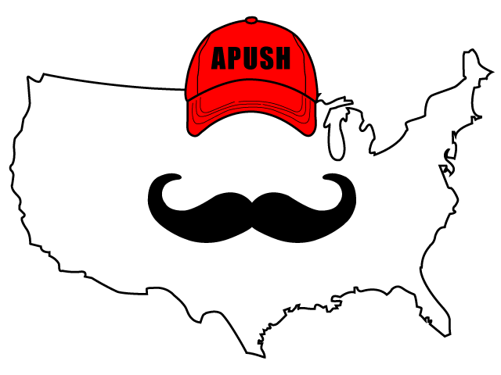
APUSH Review: Video #14: State Constitutions And The Articles Of Confederation After The American Revolution (Key Concept 3.2, II, A-B; 3.3, I, C)
Shoutout to Mr. Prophet’s class in San Fransisco! Thanks for watching
Everything You Need To Know About State Constitutions And The Articles Of Confederation To Succeed In APUSH
www.APUSHReview.com

Slide 2

New State Constitutions
Many constitutions placed property qualifications for voting and citizenship
  Fear of the masses
    Most property qualifications would be eliminated during Andrew Jackson’s presidency
State governments:
  Most powerful branch was the legislative
    Elected by the voters
    Fear of a British monarch

Slide 3
Articles Of Confederation
Think one word
  WEAK!
The Articles were purposely designed this way. Why?
  Fear of a strong central government like Britain
How were the Articles weak?
  No executive branch
  Unicameral legislature with one vote per state
  State legislatures had incredible power

Slide 4
Issues Under The Articles Of Confederation
International Trade:
  Britain refused commercial treaties with US
  Spain cut off access to MS River
Finances
  Federal government could not tax - very little source of revenue
  Each state could coin its own $ - differing values, inflation in some states
    Difficulties with trade

Slide 5
Issues Under The Articles Of Confederation
Interstate Commerce:
  Each state could place tariffs on goods from other states
  Federal government had no control over Interstate trade
    Trade between two or more states
Foreign Relations
  Weak government could not force Britain to leave posts after Rev. War

Slide 6
Issues Under The Articles Of Confederation
Internal unrest:
  Shays’ Rebellion:
    Economic issues in the 1780s
    Farmers in MA protested farm foreclosures and high state taxes
    Rebellion lasted months -> no national military to stop it
All these issues led to many Americans wanted to revise the Articles

Slide 7
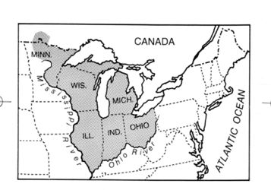
A Positive Of The Articles Of Confederation
Northwest Land Ordinance (1787)
  Nation could admit new states (once a population of 60,000 was reached)
  Guaranteed freedom of religion and trial by jury
    PRIOR to the Bill of Rights
  Proceeds from the 16th square mile of 36 square miles went towards education
  Abolished slavery
  Protection of private property

Slide 8
Quick Recap
Voting under state constitutions
Issues under Articles:
  Trade
  Finance
  Foreign Relations
  Internal Unrest
Northwest Land Ordinance

Slide 9
See You Back Here For Video #15: The Constitutional Convention, Compromises, And The Federalist Papers
Thanks for watching
Best of luck!

