Slide 1

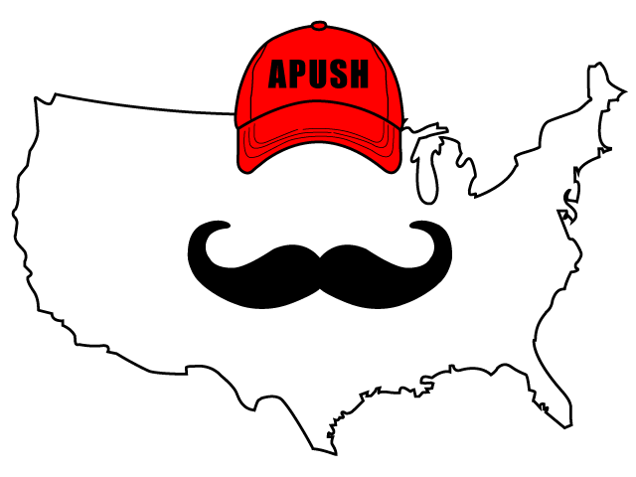
APUSH Review: Video #3: Spanish Exploration And Colonization (Key Concept 1.2, II, A-D)
Shoutout Time! Mrs. Reid’s class at Northbrook High School. Thanks for your support. Good luck!
Everything You Need To Know About Spanish Exploration And Colonization To Succeed In APUSH

Slide 2
Impacts Of Spanish Exploration
Deadly epidemics:
  Smallpox, malaria
    Killed as many as 90% of Natives in some areas - not immune to European diseases
New animals and crops not found in Americas:
  Horse - transformed Native life on the Great Plains
  Crops - wheat, rice, and sugar -> arduous labor

Slide 3
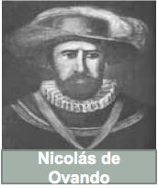
Encomienda System
Native American labor was marshaled (arranged, assembled) on plantations
The goal was to use labor for agriculture and precious metals in mines
Eventually, the system was replaced by African Slave labor

Slide 4
Beginnings Of African Slavery
Europeans partnered with some West African groups:
  Forcibly extracted slave labor for the Americas
Spanish imported slaves for plantations and mines

Slide 5
Spanish Caste System
Incorporated Europeans, Africans, and Natives
Carefully defined the status of each group
  Europeans were at the top
    Peninsulares and Creoles
  Mestizos (Mixed European and Native ancestry)
  Mulatos (Mixed European and African ancestry)
  Natives and slaves were on the bottom of the caste system

Slide 6
Quick Recap
Impact of Spanish exploration on Americas?
What was the Encomienda System?
Why did slavery develop?
What was the Spanish caste system?

Slide 7
See You Back Here For Video #4: Interactions Between Natives and Europeans
Thanks for watching
Best of luck on your tests!

