Slide 1
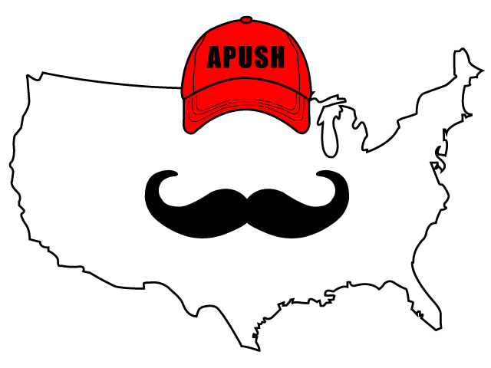
APUSH Review: Video #4: Interactions Between Natives And Europeans (Key Concept 1.2, II, A-C)
Everything You Need To Know About Interactions Between Natives And Europeans To Succeed In APUSH

Slide 2
Early Interactions
Misunderstandings between each group:
Gender - many Native societies were matrilineal
Land - Natives did not own individual land
Religion - Many Natives believed in animism, polytheistic; shamans had power
Each group adopted aspects of each other’s culture
Natives adapted technology
Europeans adapted agricultural techniques

Slide 3
Early Interactions
Native resistance to European encroachment and forced labor:
Natives sought to preserve political, economic, gender, and religious autonomy
Seen through:
Diplomatically:
Ally with different European countries against other tribes
Militarily:
Guale Indians rebelled against Spanish forts in Florida in 1597

Slide 4
Debates Over How Non-Europeans Should Be Treated
Many Europeans saw Natives and Africans as “savages”
Juan de Sepulveda:
Advocated harsh treatment of Natives
Claimed slavery for Natives was justified under Christianity
Bartolome de Las Casas:
Argued that Natives deserved the same treatment as all others
Played an instrumental role in ending the encomienda system

Slide 5
How was the subjugation of Africans and Natives Justified?
Religious:
Curse of Ham - used as a biblical justification for slavery
Cultural:
Like Native Americans, Africans were often seen as “savages” or “barbaric”
Racial:
Polygenism - theory that human races are of different origins
Used to justify the subjugation of African Americans

Slide 6
Quick Recap
How did Europeans and Natives differ in their views over:
Land
Religion
Gender
How did Natives seek to preserve their autonomy?
What were reasons used to justify the subjugation of Africans and Natives?

Slide 7
See You Back Here For Video #5: European Exploration
Thanks for watching
Best of luck on your tests!

