Slide 1

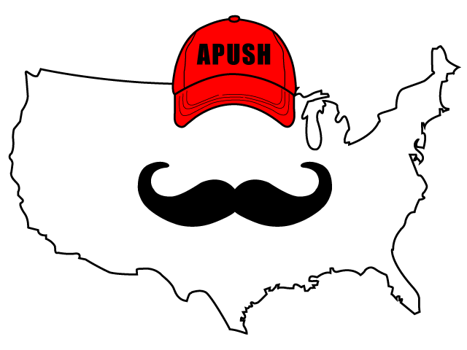
APUSH Review: Video #5: European Colonization In The Americas (Key Concept 2.1, I, A-D)
Shout out to Mr. Brower’s class in West Michigan. Best of luck!
Everything You Need To Know About European Exploration To Succeed In APUSH
WWW.APUSHReview.com

Slide 2

European Exploration
Reasons for exploration:
  3 Gs (Gold, Glory, God)
  Technological improvements:
    Sextant, caravel
Possible Contextualization for an essay on European colonization

Slide 3
Spanish Colonization
Spain sought precious metals (gold and silver)
Spanish Conquistadores:
  Hernan Cortes - Tenochtitlán, 1519, conquered the Aztecs due to advanced weapons and disease
  Francisco Pizarro - conquered the Incas in Peru

Slide 4
Spanish Colonization
The Spanish Crown had tight control over its colonies
  Royal officials were mostly appointed FROM Spain, rather than the colonies
Most settlers were men
  Intermarriage with Natives and Africans
Emergence of a caste system:
  Mestizo - mixed Spanish and Native ancestry
  Mulatto - mixed Spanish and African ancestry

Slide 5
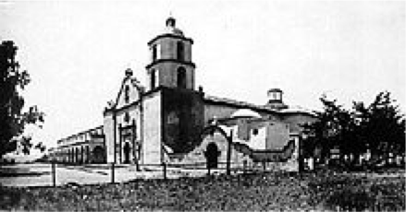
Spanish Interactions With Natives
Natives were often seen as “uncivilized”
Encomienda System:
  Royal land grants to Spanish settlers; promise to Christianize Natives on the land and gain tribute
    Natives were often enslaved on plantations and/or mines
Desire to convert Natives to Christianity (Catholicism)
  Mission System - helped convert Natives

Slide 6
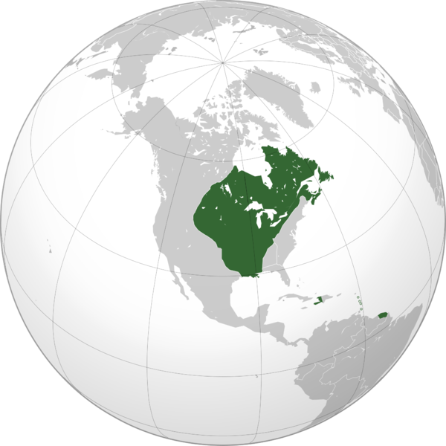
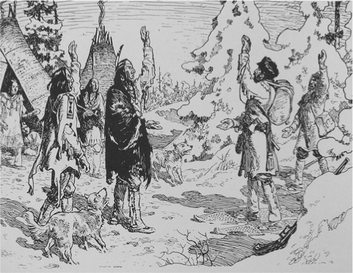
French Colonization
Samuel de Champlain founded Quebec in 1608 (1 year after the English founded Jamestown)
Sent fewer individuals than Spanish and English
  Mostly men
    Like Spain, France accepted intermarriage (metis)
France focused on trade with Natives - friendly relations with Natives
  Fur trade
  Coureurs des bois - French “runners of the woods”
  Exported goods to Europe

Slide 7
French Colonization
French colonial governments:
  Led by a governor-general that was appointed by Paris
  No representative assembly
Relations with Natives:
  Did not take a substantial amount of Native land (like English)
  Did not force them into slavery (like Spanish)
  Christian Indians were allowed to have a lot of autonomy (independence)
  Many Natives were killed by disease

Slide 8
Dutch Colonization
Henry Hudson reached NY in 1609
  Established trade posts in NY - Manhattan and Albany
Similar to the French, sent few Europeans and focused on trade
Created the joint-stock company - pooling $ together and sharing in profits and losses
  Helped lead to modern capitalism
Married women retained rights when married (unlike English women who lost their land)
Some religious toleration - privately, not publicly

Slide 9
English Colonization
1st permanent settlement was Jamestown in 1607
Settled along the Atlantic coast in present-day US and the Caribbean
Sent large numbers of males AND females
  Little intermarriage with Natives
Included immigration from other European countries
Immigrants sought:
  Social mobility
  Economic prosperity - chance to acquire land
  Religious freedom - Puritans in Massachusetts
  Improved living conditions

Slide 10
English Colonization
English colonists often lived separately from Natives
  Natives helped colonists survive during early years
    Taught colonists to grow crops and fish
Colonists focused on agriculture:
  Southern colonies - tobacco
  Middle colonies - cereal crops
  New England colonies - subsistence farming
Colonists frequently fought with Natives over land

Slide 11
English Colonization
English colonies were more democratic than other European colonies (more in next video)
England promoted mercantilism:
  Colonists exist for the mother country
    Provide raw materials and markets
  Focused on controlling balance of trade
Navigation Acts - allowed for colonies to trade ONLY with England
  Many colonists resisted these acts and smuggled
Mother Country
Gold
Raw Materials
Colonies

Slide 12
Quick Recap
Spanish:
  Mostly men -> intermarried with Natives
  Encomienda System
  Controlled by the Crown
French and Dutch:
  Few settlers, most of whom were men
  Trade alliances with Natives - fur
English:
  Men AND women -> lived separately from Natives
  Forms of democracy
  Included other European immigrants
  Sought freedoms - economic, religious, and social mobility

Slide 13
See You Back Here For Video #6: British Colonies
Thanks for watching
Best of luck on your tests

