Slide 1

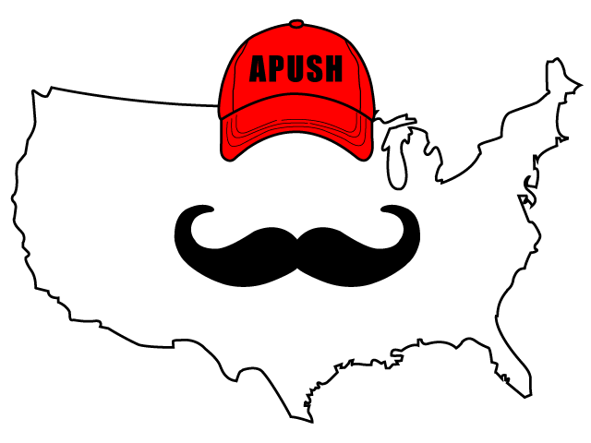
APUSH Review: Video #6: British Colonies (Key Concept 2.1, II, A-E)
Everything You Need To Know About The British Colonies To Succeed In APUSH
Shoutout to Ms. Sexton’s class in Italy! Thanks for watching
www.APUSHReview.com

Slide 2
Chesapeake And North Carolina
What is the Chesapeake?
  Maryland and Virginia
Located on the Chesapeake Bay

Slide 3
Chesapeake And North Carolina
Predominantly agriculture - rural settlements
  Cash crops - tobacco
    Arduous, labor-intensive, work
Indentured Servants made up most of the work force prior to Bacon’s Rebellion (1676)
  Headright System benefitted wealthy landowners - 50 acres for each indentured servant they the passage for
After 1676, African slave labor replaced indentured servants
Jamestown

Slide 4
Chesapeake And North Carolina
Demographics:
  Some families
    Mostly white, male, indentured servants
  Lower life expectancy than New England and Middle Colonies
Maryland Acts of Toleration:
  Granted religious toleration to ALL Christians (specifically aimed to protect Catholics)
Cecil Calvert

Slide 5
New England Colonies
Massachusetts, Rhode Island, Connecticut, and New Hampshire
Initially settled by Puritans - wanted to “purify” the Anglican (English) Church
  Massachusetts Bay - John Winthrop
    “City Upon a Hill”
    Not religiously tolerant
      Roger Williams and Anne Hutchinson were banished for challenging the Church
Rhode Island
  Founded by Roger Williams
  Religious toleration
  Paid Natives for land

Slide 6
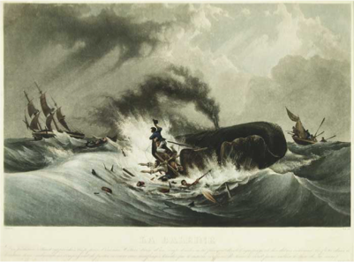
New England Colonies
Small Towns
Family farms (not plantations like the South)
Mixed Economy - agriculture and commerce
  Merchants, shipbuilding, whaling, etc.
Slavery did exist, just on a smaller scale

Slide 7
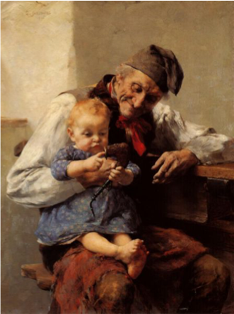
New England Colonies
More likely to see extended families than other regions
  Grandparents too!
Higher life expectancy than other regions

Slide 8
Middle Colonies
New York, Pennsylvania, New Jersey, and Delaware
Economy was based on cereal crops for export
  Grains, wheat, etc. (Breadbasket Colonies)
  Also shipbuilding - lots of forests
William Penn’s “Holy Experiment”
  Religious toleration
  Like RI, they paid Natives for their land

Slide 9
Middle Colonies
Demographics:
  Most diverse of all regions
    Many countries from Europe
      Scotts-Irish, German Provinces, Netherlands
    Religious toleration - freedom of religion
  Large amount of indentured servants and slaves

Slide 10
Southern Atlantic Coast And West Indies
South Carolina, Georgia, West Indies
Economy was based on:
  Export staple crops
    Tobacco, sugar, rice
    Large plantations
Most slaves went to Brazil or the West Indies

Slide 11
Southern Atlantic Coast And West Indies
Demographics:
  In many cases, African slaves made up most of the population
    Led to harsh slave codes
Slaves sought autonomy through:
  Culture:
    Language - Gullah in SC and GA
    Built African-style houses
  Religion - many Africans practiced a form of animism
    Adopt Protestant and Catholic practices to their religions

Slide 12
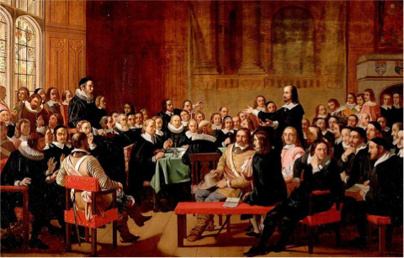
English Colonial Governments
For their time, they were very democratic
New England - Town Hall Meetings:
  Voting was limited to land-owning, white, male, church members
  These voters elected colonial legislatures

Slide 13
English Colonial Governments
Southern Colonies - politics were dominated by elite planters
Governor was appointed by England
Virginia House of Burgesses (1619)
  First Representative government in the colonies
  Voting requirements - mostly landowning, white men

Slide 14
Quick Recap
Chesapeake:
  What colonies was it?
  Original labor source?
  Why did it switch to African slavery?
New England:
  How did religion impact this region?
  What was the economy like?
Middle colonies:
  Economy was based on?
  How did religion impact the colonies?
  Most diverse region
Southern colonies:
  Crops - tobacco, rice, sugar
  Slaves outnumbered whites -> slave codes
  How did slaves preserve their autonomy?
Types of governments in NE and Southern colonies?

Slide 15
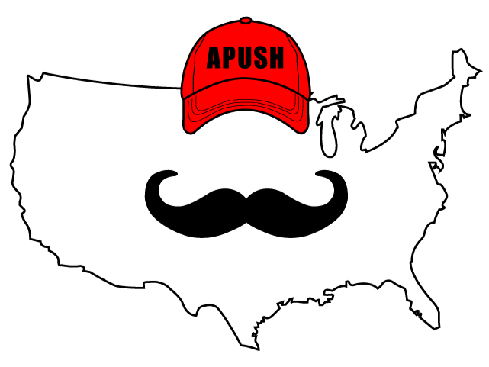
See You Back Here For Video #7: The Atlantic Economy And European Interactions With Native Americans
Thanks for watching
Best of luck on your tests

