Slide 1

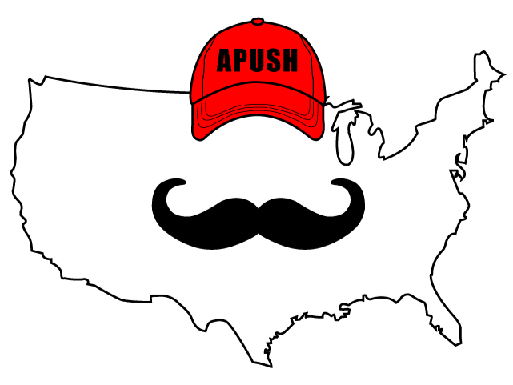
APUSH Review: Video #7: The Atlantic Economy And European Interactions With Native Americans (Key Concept 2.1, III, A-C)
Everything You Need To Know About The Atlantic Economy And European Interactions With Native Americans To Succeed In APUSH
Shoutout to Mr. Pedersen’s class in San Antonio, TX!
www.APUSHReview.com

Slide 2
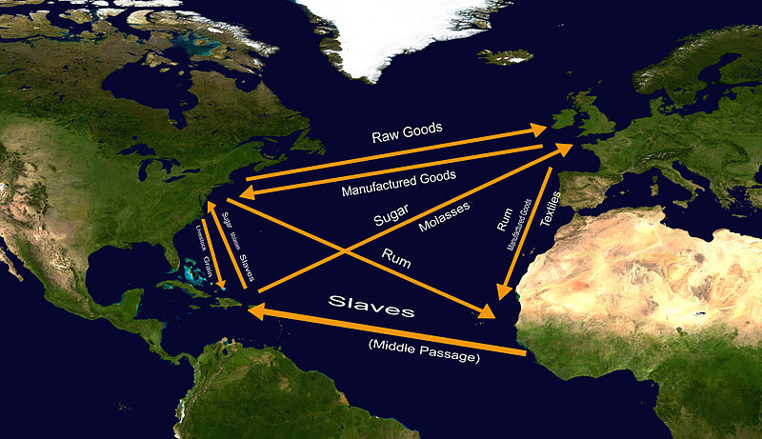
The Atlantic Economy
Trade between Europe, Africa, and the Americas
  Goods were exchanged between the three areas
  Enslaved Africans and Natives were also exchanged
    Middle Passage
Colonies focused on:
  Acquiring commodities that were valued in Europe
    Fur trade
  Producing commodities that were valued in Europe
    Tobacco - Chesapeake
    Sugar - Southern Atlantic and West Indies
  Exporting commodities that were valued in Europe
  Gaining new sources of labor
    Increase in African Slave Trade after 1676 (Bacon’s Rebellion)

Slide 3
Impacts Of Trade On Native Communities
Contact and trade with Europeans drastically impacted Native Communities
  Cultural changes
    Europeans sought to assimilate Natives into their societies (Spanish)
    Natives were sold into slavery in the West Indies
    Guns and horses made tribes more powerful
  Economic changes
    Loss of land as plantations spread further west
  Demographically
    Epidemic diseases - drastically decreased Native populations

Slide 4
European And Native American Interactions
Interactions between the two groups fostered (promoted the growth of) accommodation and conflict
  Spain became more accommodating to Natives after the Pueblo Revolt
  British colonies often had conflict with Natives over land
    Metacom’s (King Philip’s) War
      Native resistance decreased in New England
      Many Natives were killed or sold into slavery in the West Indies

Slide 5
European And Native American Interactions
Native tribes sought alliances with Europeans against other American Indian Groups
  Pequot War
    Colonists from Massachusetts and Connecticut allied with Narragansett Native Americans against the Pequots
    Many Pequots were killed, others were sold into slavery

Slide 6
Quick Recap
Impact of the Atlantic Trade on Africa, Europe, and Americas
How did trade with Europeans impact Native Americans?
Be able to identify and explain a conflict between Natives and Europeans (Pueblo Revolt, Metacom’s War, Pequot War)

Slide 7
See You Back Here For Video #8: Goals and Interests of Colonists, Metacom’s War, and the Pueblo Revolt!
Best of luck on your tests
Thanks for watching!

