Slide 1

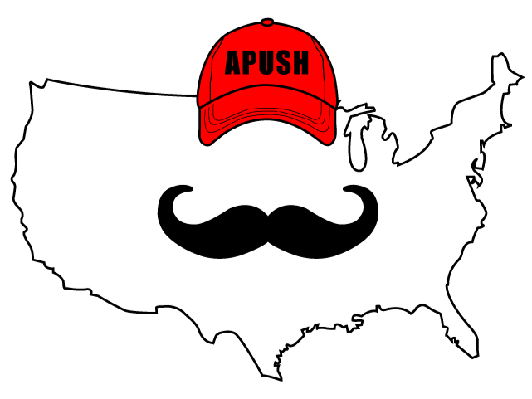
APUSH Review: Video #8: Goals And Interests of Colonists, Metacom’s War, and the Pueblo Revolt (Key Concept 2.1, III, D-F)
Everything You Need To Know about goals and interests of colonists, Metacom’s War, and The Pueblo Revolt To Succeed In APUSH
Shoutout to Mrs. Fletcher’s class in Cedar Hill. You rock!
www.APUSHReview.com

Slide 2
European and Colonial interests often varied
Over time, both sides increasingly mistrusted each other
British colonists sought to expand (especially pre and post 7 Years’ War), Britain resisted this
Colonists were upset over:
  Territorial settlements and frontier defense - as seen in Bacon’s Rebellion
  Self-rule - Governors were often appointed by the British
    Edmund Andros - governor of the unpopular Dominion of New England - restricted town meetings
  Trade - Navigation Acts - could only trade with Britain
    Colonists often resisted by smuggling

Slide 3
British And Native American Conflicts - Metacom’s War
Metacom (King Philip to the colonists) was the leader of the Wampanoag Indians
  Sought to live in harmony with colonists in NE
    Encroachment by colonists led to issues
1675 - 3 Wampanoags were hanged in Plymouth

Slide 4
British And Native American Conflicts - Metacom’s War
Initially, Metacom’s side was successful
The Iroquois Indians gave aid to the colonists
1678 - war ended
  Metacom was captured and killed
    Many Natives were sold into slavery
Significance of war?
  Reinforcement of Natives seen as “savages”
  Native resistance in NE decreased
  Continuation of colonial expansion onto Native land

Slide 5
Pueblo Revolt (Spanish Colonies)
Pueblos:
  Natives located along the Rio Grande region of the Southwestern US
  Pueblo is Spanish for town; named after their distinct buildings
Spanish established Sante Fe in 1610 and ruled the Pueblos harshly
  2,000 Spanish and 30,000 Pueblos

Slide 6
Pueblo Revolt (Spanish Colonies)
Causes of the revolt:
  Spanish priests and government suppressed Native practices inconsistent with Christianity
  Spanish demanded tribute and land
The revolt:
  Pope (Native religious leader) killed hundreds and forced Spanish to flee
  Spain regained control in 1692
Significance of revolt?
  Spain became more accommodating to the Natives
    More religious tolerance

Slide 7
Quick Recap
Tensions between colonists and England over:
  Frontier defense
  Self-rule
  Trade
Metacom’s War and its impacts on Natives
Pueblo Revolt and its impact on Natives

Slide 8
See You Back Here For Video #9: Impact Of Transatlantic Exchanges - 1st Great Awakening, Enlightenment, and Mercantilism
Thanks for watching
Best of luck!

