Slide 1

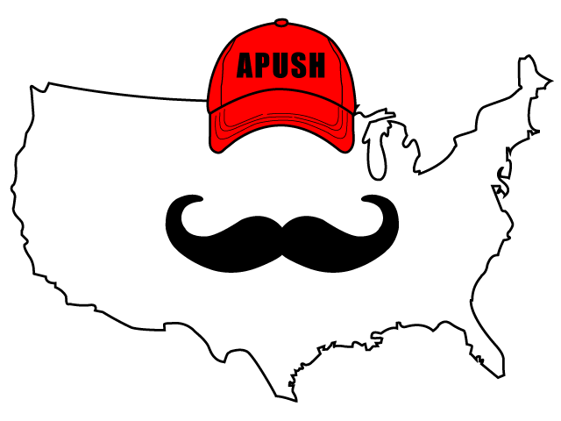
APUSH Review: Video #15: The Constitutional Convention, Compromises, and the Federalist Papers (Key Concept 3.2, II, C - E)
Everything You Need To Know About The Constitutional Convention, Compromises, and the federalist papers to succeed in APUSH
Shoutout to Mr. Ahrns’ Class In Ohio. Best of luck!
www.APUSHReview.com

Slide 2
Background On The Constitutional Convention (Historical Context)
Articles were designed to have a weak central government
Annapolis Convention (1786)
  Purpose was to improve the economy
  Only 5 states showed up
  Alexander Hamilton saved the day
  Promise for another convention in 1787……

Slide 3


Constitutional Convention
National Government
States
Both
Delegates from 12 states went to Philly in 1787
Structure of the government:
  Limited government - limits on what the federal government can do
  Separation of powers and checks and balances
  Federalism - powers divided between states and federal government
Coin $
10th Amendment
Collect
Taxes
Education
Declare War
Licensing
Professionals
Make treaties
Enforce
Laws
Establish
Post Offices
Marriage and
Divorce
Borrow
& Spend
$

Slide 4
Constitutional Compromises
Congressional Representation:
  VA Plan - proposed representation to be based on population
    Would favor large states
  NJ Plan - proposed representation to be equal per state (similar to Articles)
  Great Compromise
    Combined elements of VA and NJ Plans
    1 part of legislature would be based on population (House of Reps)
    1 part of legislature would be equal representation (Senate - 2 per state)
VA Plan = Population
+
NJ Plan = Equal Representation
=
Great Compromise = 1 house based on representation, 1 house has equal representation

Slide 5
Constitutional Compromises
3/5 Compromise:
  3/5 (60%) of slaves would count towards representation in the House
    Favored southern states
Slave Trade Compromise:
  Congress could not allow the international slave trade until 1808 (which they did)
    Check out Cabinet Battle #3 from the Hamilton mixtape

Slide 6
Ratification Debates
Federalists - those that supported the ratification of the Constitution
Anti-Federalists - those that opposed ratifying the Constitution
Federalist Papers:
  85 essays to defend the Constitution and encourage ratification
  Federalist #10 - factions and controlling factions
  Federalist #51 - Separation of Powers and Checks and Balances

Slide 7
Ratification Debates
So… why did Anti-Federalists ultimately ratify the Constitution?
  The Federalists promised to add a BILL OF RIGHTS!
    1st Ten amendments
    Restrict powers of the federal government and preserve liberties and freedoms

Slide 8
The Bill Of Rights
1: Five Freedoms
  Religion, Assembly, Press, Petition, and Speech
2:
  Right to bear arms
3:
  No quartering of troops
4:
  No unreasonable search and seizures
5:
  Grand jury; no double jeopardy; can’t testify against yourself; can’t lost property, life, or liberty without a trial

Slide 9
The Bill Of Rights
6:
  Speedy trial; right to an attorney; cross examination; witnesses that are favorable
7:
  Jury trial in a civil suit
8:
  No cruel and unusual punishment
9:
  Rights not listed are not necessarily denied
10:
  Powers not delegated (given) to the federal government are reserved for the states or people

Slide 10
Quick Recap
Annapolis Convention
Great Compromise
3/5 Compromise
Slave Trade Compromise
Federalist Papers
Bill of Rights

Slide 11
See You Back Here For Video #16: The Presidencies of Washington and Adams, and the 1st Party System
Thanks for watching
Best of luck!

