Slide 1

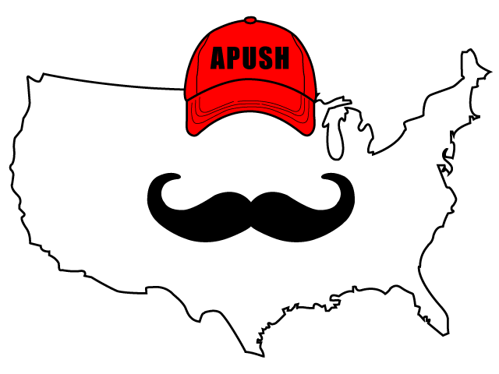
APUSH Review: Video #16: The Presidencies of Washington & Adams, And The 1st Party System (Key Concept 3.2, III, A-B)
Shoutout to Mr. Albert’s Class in Minnesota. Best of luck this year!
Everything You Need To Know About The Presidencies of Washington & Adams, And The 1st Party System To Succeed In APUSH
www.APUSHReview.com

Slide 2

Institutions And Precedents Set During Washington’s And Adams’ Administrations
Institutions:
  Bank of the United States (Washington)
    Brainchild of Hamilton
    National Bank would help establish United States credit and improve trade
      Strict vs. loose interpretation
    Ultimately, Washington supported the BUS

Slide 3
Institutions And Precedents Set During Washington’s And Adams’ Administrations
Precedents
  Actions that were taken that were followed by future presidents
    2-term tradition:
      Washington served only 2 terms
        Followed by all presidents until FDR
          22nd Amendment
    Presidential Cabinet:
      Advisors to the president - heads of departments

Slide 4
1st Party System
Federalists:
  Led by Alexander Hamilton
  John Adams
  Washington sided with many Federalist policies but was NOT a member of the party
Democratic-Republicans:
  Led by Thomas Jefferson and James Madison

Slide 5
So…. Why did they develop?
4 Main Reasons:
Power of the Federal Government
Foreign Policy (Stemming from the French Revolution)
Economic Policy (Stemming from Hamilton’s Financial Plan)
Balance between liberty and order (Stemming from Alien and Sedition Acts)

Slide 6
Power of the Federal Government
Federalists favored a stronger national (federal, central) government
Democratic-Republicans favored a smaller federal government
  Madison and Jefferson argued that states should be able to nullify federal laws
    VA and KY Resolutions

Slide 7
Foreign Policy
Democratic-Republicans tended to support France
  France provided aid during Rev. War
  Declaration of Independence inspired the French Rev.
Federalists wanted to have a beneficial relationship with England
  Major trading partner
  Jay’s Treaty (1794)
    US acknowledged England as favored trading partner
      Upset France

Slide 8
Economic Policy
Hamilton’s Financial Plan pitted Hamilton against Jefferson and Madison
Bank of the US (BUS) was the most controversial aspect
  Strict (Democratic-Republicans) vs. Loose (Federalists) Interpretation of the Constitution
Ultimately, Washington supports the BUS and sides with the Federalists

Slide 9
Balance Between Liberty And Order
Alien and Sedition Acts (1798, Adams Administration)
  Meant to silence Adams’ Democratic-Republican opponents
  Punishments for criticizing included fines and/or jail time
Jefferson (Adams’ VP) and Madison responded with the VA and KY Resolutions
  Urged states to nullify the Alien and Sedition Acts
You Will NOT Silence Me!

Slide 10
Check Out The Hamilton Soundtrack
Cabinet Battle #1 (Bank and Financial Plan)
Cabinet Battle #2 (Conflict between France and England)
One Last Time (Washington’s Farewell Address)
Every other song because they’re amazing

Slide 11
Quick Recap
Institution under Washington
  BUS
Precedents established:
  2 term tradition
  Cabinet
Reasons for the development of the 1st Party System
  Great Short Answer Question
  Great Essay Question comparing with the Second Party System

Slide 12
See You Back Here For Video #17: Europe’s Presence In North America, War Between France and England, And Washington’s Farewell Address
Thanks For Watching
Best of luck

