Slide 1

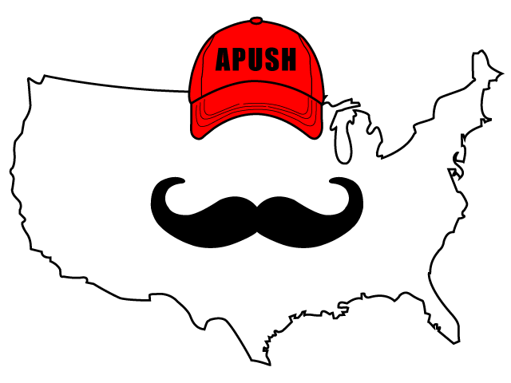
APUSH Review: Video #17: Europe’s Presence In North America, War Between France & England, And Washington’s Farewell Address (Key Concept 3.3, II, A-C)
Shoutout to Mrs. Henley’s Class in Atlanta, GA. Thanks for your support!
Everything You Need To Know About Europe’s Presence In North America, War Between France & England, And Washington’s Farewell Address
www.APUSHReview.com

Slide 2
Europe’s Presence In North America (Post-Revolutionary War)
Britain continued to occupy posts in the US
  Presence in Canada too
Spain controlled the Mississippi River
  LA Purchase was given to Spain by France
    Would be given back to France soon

Slide 3
Europe’s Presence In North America (Post-Revolutionary War)
Diplomatic Initiatives to deal with England and Spain
  Jay’s Treaty (1795):
    Treaty with Britain
    US received compensation for damaged ships
    Britain promised to leave posts - they didn’t
    Granted Britain favored trading status
      Upset Democratic-Republicans that supported France
    Major cause of the development of political parties
  Pinckney’s Treaty (1795):
    Treaty with Spain
    US was granted navigation rights on the MS River
      Right of Deposit in New Orleans

Slide 4
War Between France And England
French Revolution (1789):
  Overthrew the French monarch, King Louis XVI
Shortly after France and England go to war
  Both sides wanted to keep the US from siding with the other
    Impressment - forced taking of soldiers into the British navy
France hoped US would provide aid
  Return favor from Battle of Saratoga
  Democratic-Republicans wanted to side with France
Major cause of the formation of 1st Party System (previous video)

Slide 5
Washington’s Farewell Address
Issued in 1796 as Washington left office
Written by Washington and his boy Hamilton
Helped influence US foreign policy for years to come
  Another precedent
  Great connection to another time period in a foreign policy essay

Slide 6
Washington’s Farewell Address
Washington warned of foreign entanglements
  His ghost will hover over foreign policy debates until WWII
He also warned of political parties
  Not followed by the country
Check out Hamilton’s “One Last Time”

Slide 7
Quick Recap
Britain in posts post Revolutionary War
Jay’s Treaty -> political parties
Pinckney’s Treaty -> MS River
Washington’s Farewell Address -> EVERYTHING

Slide 8

See You Back Here For Video #18: Art, Literature, Architecture, Native Americans, And Frontier Cultures
Thanks for watching!
Best of luck

