Slide 1
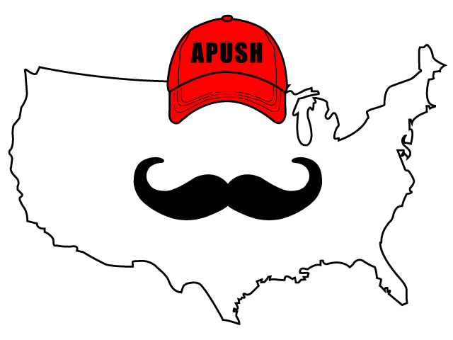
APUSH Review: Video #18: Art, Literature, Architecture, Native Americans, And Frontier Cultures (Key Concepts 3.2, III, D, 3.3, I, A-B, D)
Everything You Need To Know About Art, Literature, Architecture, Native Americans, And Frontier Cultures To Succeed In APUSH
Shoutout to Mr. Brower’s class. You rock!
www.APUSHReview.com

Slide 2
Art, Literature, And Architecture
National identity was expressed through these art mediums
Art:
Gilbert Stuart - painted portraits of the first 6 presidents
John Trumbull - Painted pictures of key American events
Literature:
Focused on freedom and defining the government
Jefferson’s Virginia Statute for Religious Freedom
Architecture:
Jefferson and Monticello
Pierre Charles L’Enfant and D.C.

Slide 3
Native Americans
Natives sought to limit American expansion west
Battle of Fallen Timbers (1794 - Ohio)
Natives led by Little Turtle were defeated
Treaty of Greenville - Natives ceded a significant amount of land
British alliances with Natives contributed to tensions with America - pre-War of 1812
Constitution gave no mention of the treatment/relations with Natives
Treaties were not always enforced
States did not always follow treaties (Seen in period 4 - Indian Removal Act)

Slide 4
Frontier Cultures
As Americans moved westward, distinct frontier cultures developed
Scots-Irish (Paxton Boys):
Tended to settle on the frontier (edges of settlement)
Settled on land without regard for ownership (government, Natives, etc.)
Displaced and suppressed Native Americans
Illustrates tensions between poor (backcountry) and wealthy (interior)

Slide 5
Quick Recap
Art, Architecture, and Literature in regards to national identity
Native Americans under the Constitution:
No definition of relationship
Paxton Boys and frontier culture
That’s it for period 3!

Slide 6
See You Back Here For Video #19!
Thanks for watching
Best of luck!

