Slide 1
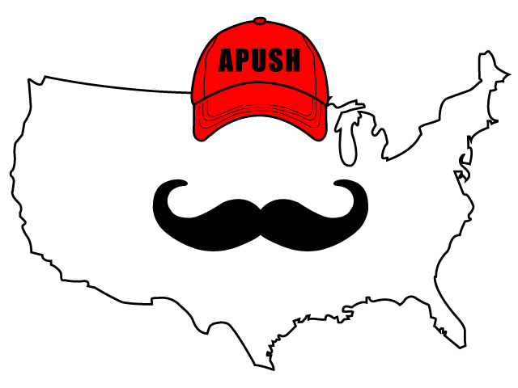
APUSH Review: Video #22: African American Communities And The Missouri Compromise (Key Concepts 4.1, II, D, 4.3, II, D)
Shoutout to Mr. Dailey’s Class at Westbrook High School!
Everything You Need To Know About African American Communities And The Missouri Compromise To Succeed In APUSH
www.APUSHReview.com

Slide 2
African American Communities
Enslaved African Americans created communities and strategies to:
Protect their dignity and family structures
“Surrogate” families when a slave was sold
Slave music - used to help pass time while working
Instrumental in religious services
Joined political efforts to change their status
American Anti-Slavery Society (more in video #26

Slide 3
Missouri Compromise (Compromise of 1820)
Background (Historical Context)
22 states in the country - 11 free and 11 slave
Missouri applied for statehood in 1819 from LA Territory
Would upset balance of free and slave states
Tallmadge Amendment
Would allow for emancipation of children of slaves
House favored it, Senate rejected it

Slide 4
Missouri Compromise (Compromise of 1820)
Henry Clay helped mollify the dispute
3 Parts of the Compromise
Missouri was added as a slave state
Maine was added as a free state
All future states in LA Territory above 36°30’ would be slave, below would be free

Slide 5
Impact Of Missouri Compromise (Compromise of 1820)
Balance remained at 12 free, 12 slave states
States were admitted in alternating free and slave in short-term
Lasted 34 years
As the US expanded beyond the LA Territory, slavery became the #1 issue
New compromises/court cases would attempt to address issue

Slide 6
Quick Recap
African American Communities
3 parts of the MO Compromise (1820)

Slide 7
See You Back Here For Video #23: Sectionalism & The American System
Thanks for watching
Best of luck!

