Slide 1
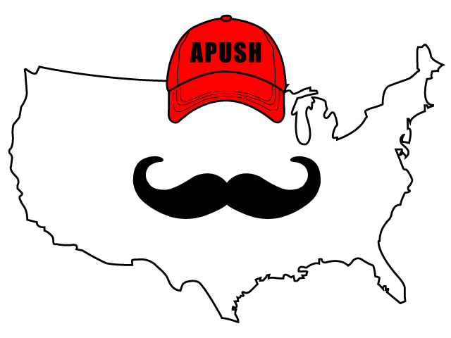
APUSH Review: Video #20: Supreme Court Cases In The Early 1800s and National Culture (Key Concepts 4.1, I, B, 4.1, II, B, 4.2, I, C)
Shoutout to Mrs. Hawkin’s Class in Virginia. Good luck this year!
Everything You Need To Know About Supreme Court Cases In The Early 1800s And National Culture To Succeed In APUSH
www.APUSHReview.com

Slide 2
The Court In The Early 19th Century
Key Concept 4.1, I, B:
“Supreme Court decisions established the primacy of the judiciary in determining the meaning of the Constitution and asserted that federal laws took precedence over state laws.”
What court case established the “primacy of the judiciary….”?
Marbury v. Madison - established Judicial Review
Supreme Court can declare a law unconstitutional

Slide 3
The Court In The Early 19th Century
Key Concept 4.1, I, B:
“Supreme Court decisions established the primacy of the judiciary in determining the meaning of the Constitution and asserted that federal laws took precedence over state laws.”
What court cases “asserted that federal laws took precedence over state laws”?
Gibbons v. Ogden - Congress has sole control over INTERstate trade, not states
McCulloch v. Maryland - BUS is constitutional, states CANNOT tax federal agencies

Slide 4
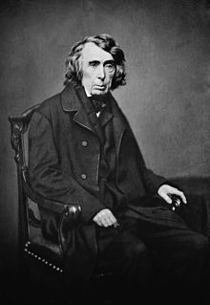
The Court In The Early 19th Century
Key Concept 4.2, I, C:
“Legislative and judicial systems supported the development of roads, canals, and railroads…….”
What court case supports this statement?
Charles River Bridge (1837)
Contracts could be altered to benefit the general welfare
Charles River Bridge company lost its monopoly on the Charles River

Slide 5
National Culture
**Transcendentalists**
Focus on ones self and looking for God in nature
Challenged materialism of the 19th-century
Stressed individualism
Examples of transcendentalists
Ralph Waldo Emerson:
Helped create a distinct American culture
Self-reliance
Henry David Thoreau
Walden - lived in the woods for two years by himself
“On Civil Disobedience”
Transcendentalists were often antislavery

Slide 6
National Culture
New (Utopian) Communities:
Brook Farm - small community in Massachusetts that focused on artistic creativity and education
Oneida Community (1848) - Onedia, NY
Focused on equality, “free love,” and all members contributing to society

Slide 7
National Culture (Arts)
Art - Hudson River School focused on wilderness
Literature - writing promoted nationalism
James Fenimore Cooper - writings painted frontier people in a favorable light

Slide 8
Quick Recap
Know the following court cases:
Marbury v. Madison (1803)
Mcculloch v. Maryland (1819)
Gibbons v. Ogden (1824)
Charles River Bridge (1837)
Transcendentalists
Goals of Utopian Communities

Slide 9
See You Back Here For Video #21: The Market Revolution And Its Impacts
Thanks for watching
Best of luck!

