Slide 1
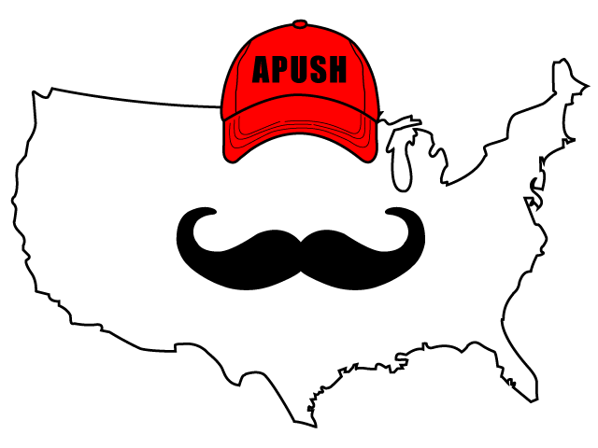
APUSH Review: Video #23: Sectionalism & The American System (Key Concepts 4.2, III, B - D)
Everything You Need To Know About Sectionalism And The American System To Succeed In APUSH
www.APUSHReview.com

Slide 2
Sectionalism
As the 19th century progressed, the North and South became more entrenched in their economies
  South:
    Cotton production and agricultural staples
  North:
    Focused on manufacturing, banking, and shipping industries
Both regions traded goods to distant markets in Europe

Slide 3
Impacts Of Cotton On The Economy
US economy increased during this time due to:
  Southern cotton production
    Sold to the North and Europe
  Northern manufacturing
    Cotton used in textile factories
  Banking
    Loans to foster the growth of industry
  Shipping industries
    Northern merchants made $ from sale of cotton and international trade

Slide 4
Impacts Of Cotton On The Economy
As the North industrialized, the South continued to produce staple crops and cash crops
Plantation owners exercised tremendous power
Many elites defended slavery and the Southern Way of life
  John C. Calhoun

Slide 5
Henry Clay’s American System
Background Info (Contextualization)
  During the early 19th century, the country faced many challenges:
    Infant US industries had a hard time competing with British goods (Post War of 1812)
    Infrastructure was weak (especially in the West - KY, OH, TN, etc.)
    1st BUS expired and 2nd BUS was rechartered in 1816 for 20 years
The goal of the American System was to address the areas

Slide 6
Henry Clay’s American System - The BUS
1st BUS created divisions between Jefferson and Hamilton
  Debate over strict v. loose interpretation of the Constitution
The Supreme Court upheld the Constitutionality of the BUS in McCulloch v. Maryland in 1819
  However opposition still persisted
    Andrew Jackson’s veto of the 3rd BUS
Henry Clay advocated the 3rd BUS - help stimulate the economy

Slide 7

Henry Clay’s American System - Internal Improvements
Inter v. Intra state trade:
  Interstate involves trade between two or more states
  Intrastate trade involves trade within a state
  For much of early American History, Congress only provided funding for interstate developments
The American System advocated federal funds to improve infrastructure - increase trade and connectivity of the country
  Many politicians, such as Andrew Jackson opposed this
    Maysville Rd. veto in KY
    James Monroe’s veto of the Erie Canal
How would the American System pay for these internal improvements?
  Tariffs!
Erie Canal - Paid for by New York State

Slide 8

Henry Clay’s American System - Tariffs
Tariff:
  Tax on foreign goods
  Price of foreign goods increases, provides revenue for government, and makes American products more appealing
Tariff of 1816, 1828, and 1832:
  Raised the price of foreign goods
    Idea was to help American industries
    Much resistance to 1828 and 1832
    Nullification Crisis in SC
Foreign Goods
Taxes

Slide 9
Analyzing The American System
Successes:
  North and Midwest were more closely linked
  Many states built up their infrastructure
  1st of many government sponsored programs in the economy
  American industries were able to prosper
Failures:
  Did not unify all areas of the US
  Sectionalism increased (Nullification Crisis)
  Continued debates about role of federal government in intrastate business

Slide 10
Quick Recap
Impacts of cotton on the economy
3 parts of the American System
  BUS
  Internal Improvements
  Tariffs
Successes and failures of the American System

Slide 11
See You Back Here For Video #24: Immigration And Native Americans
Thanks for watching
Best of luck!

