Slide 1
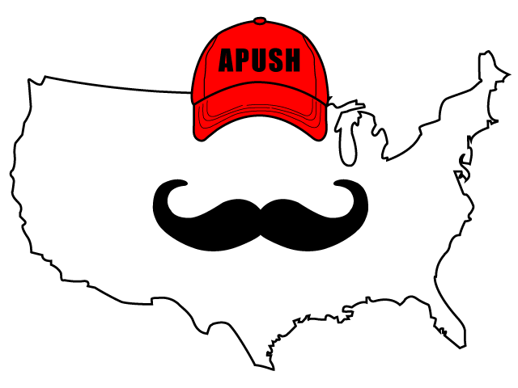
APUSH Review: Video #: The Second Party System (Key Concept 4.1, I, C-D)
Everything You Need To Know About The Second Party System To Succeed In APUSH
www.APUSHReview.com

Slide 2

Whigs And Democrats (2nd Party System)
1820s - 1830s
This time saw an increase in political participation
  Elimination of property requirements for voting and universal white, male suffrage
Differences between the parties?
  Role and power of the federal government
  National Bank (BUS)
  Tariffs
  Federally funded internal improvements
Henry Clay’s American System

Slide 3
Whigs And Democrats (2nd Party System)
Role and power of the federal government:
  Whigs tended to favor a stronger central government
  Democrats tended to favor more power to states
National Bank:
  Democrats - tended to oppose BUS
    Jackson’s veto of the 3rd BUS in 1832
  Whigs were created in response to “King Andrew I”
    Whigs favored BUS

Slide 4
Whigs And Democrats (2nd Party System)
It has no connection with any established system of improvements; is exclusively within the limits of a State, starting at a point on the Ohio River and running out 60 miles to an interior town, and even as far as the State is interested conferring partial instead of general advantages.
Tariffs:
  Tax on imported goods - tended to favor the industrialized north
  Whigs supported, Democrats opposed
Federally funded internal improvements:
  Whigs favored
  Democrats opposed
    Andrew Jackson’s Maysville Rd. veto

Slide 5
Importance Of Region In Politics
“Regional interests often trumped national concerns as the basis for many political leaders’ positions on slavery and economic policy”
Nullification Crisis - 1833:
  SC and other southern states opposed the Tariffs of 1828 and 1832 - SC nullified those tariffs
    Threatened to secede if Jackson collected the tariff by force
As the 1800s passed, the South became more entrenched in slavery
  Many northern states outlawed slavery
    NY - slavery became illegal in 1827

Slide 6
Quick Recap
Differences between Whigs and Democrats
Region’s impact on economics and slavery
Potential Essay Topic:
  Compare and contrast the reasons for the creation of the 1st and 2nd Party Systems

Slide 7
See You Back Here For Video #: Antislavery Efforts And The Expansion Of Slavery
Thanks for watching
Best of luck!

