Slide 1
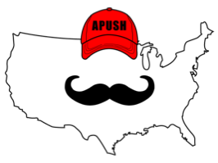
APUSH Review: Video #28 Women’s Rights And The Seneca Falls Convention (Key Concept 4.1, III, C)
Everything You Need To Know About Women’s Rights And The Seneca Falls Convention To Succeed In APUSH
www.APUSHReview.com

Slide 2

Women’s Rights Movement - An Intro
Often aligned with the abolitionist movement
Women hoped to achieve greater equality and opportunities
“Republican Motherhood” and “Cult of Domesticity”
1839, Lucretia Mott and Elizabeth Cody Stanton were prohibited from speaking or voting at an abolitionist meeting in London

Slide 3
SENECA FALLS CONVENTION (1848)
Women’s Rights Convention in NY
Declaration of Sentiments - “All men AND women are created equal”
  Hoped to achieve suffrage and greater rights for women

Slide 4
Key People Associated With The Convention
Elizabeth Cady Stanton:
  Active in the women’s rights movement and abolitionism
Lucretia Mott:
  Quaker
  Involved in women’s rights and abolitionism

Slide 5
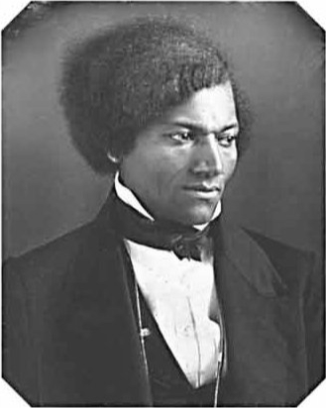
Key People Associated With The Convention
Frederick Douglass:
  Former slave, women’s rights advocate
  Only African America to attend the convention
  Advocated women’s suffrage

Slide 6
Quick Recap
Goals of the Women’s Rights Movement
Key People:
  Frederick Douglass
  E. C. Stanton
  Lucretia Mott

Slide 7
See You Back Here For Video #29: Manifest Destiny
Thanks for watching
Best of luck!

