Slide 1

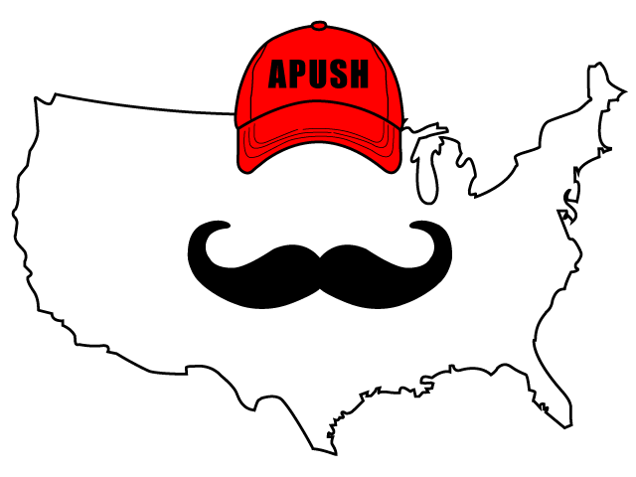
APUSH Review: The Gilded Age
Shoutout Time! Mr. Longie’s Class and their class pet Adam Norrfish, Mr. Mayer’s Class in Washington, and Mrs. Johnson’s Class at Pikesville HighSchool! Best of luck!
Everything You Need To Know About The Gilded Age To Succeed In APUSH

Slide 2
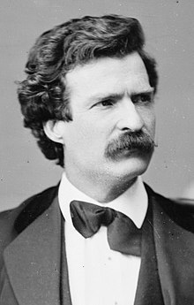
The Gilded Age: A Brief Intro
Coined by Mark Twain
  Societal problems were masked by a thin layer of gold
From 1870 - 1900
Period of technological progress and economic growth

Slide 3
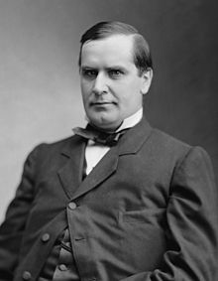
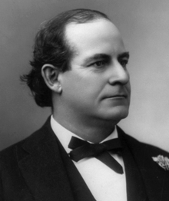
Politics & Economics During The Gilded Age
Republicans and Democrats were split over economic issues:
  Tariffs - Republicans advocated higher tariffs, Democrats advocated lower tariffs
  Currency:
    Republicans favored gold standard
    Democrats (1896) advocated Free Silver (backing up the value of the $ with silver)
      This would favor farmers and those in debt
Growing gap between rich and poor

Slide 4
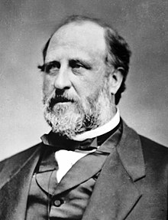
Politics & Economics During The Gilded Age
Political Machines
  Political organizations that provided jobs and services to constituents and received support in return
  Tammany Hall in NYC
  Boss Tweed - dishonest graft

Slide 5
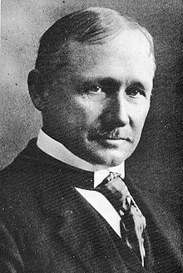
Technological Advancements During The Gilded Age
Scientific Management - Frederick Taylor, “Taylorism”:
  Focused on improving efficiency of workers - timed tasks
  Workers were given specific tasks
Mechanized tractors, grain elevators
Bessemer Process - mass produced steel

Slide 6
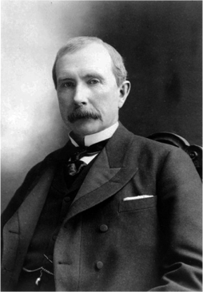
Business Consolidation During The Gilded Age
Trusts - associated with monopolies
Holding Companies - one company that owns stock in many others and controls them
Vertical Integration - owning all aspects of production of a business (start to finish)
Horizontal Integration - businesses in an industry join together and form a monopoly

Slide 7
Unions During The Gilded Age
Emerged as a response to working conditions and wages
Knights of Labor:
  Skilled and unskilled workers
American Federation of Labor:
  Skilled workers - focused on “bread and butter” issues

Slide 8
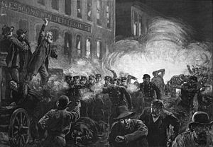
Strikes During The Gilded Age
Strikes were often a reaction to wage cuts
Railroad Strike of 1877:
  Broken up by federal troops (Hayes)
Haymarket Square Riot (1886):
  Protest in Chicago that turned violent when someone threw a bomb
  Unions were blamed
Homestead Strike:
  Carnegie steel plant
Pullman Strike:
  Company cut wages, did not cut rent prices in town

Slide 9
Farmers During The Gilded Age
Populist Party
  Response to growth of corporate power (RRs) and economic instability
  Wanted the government to have a stronger role in the economy
  Advocated:
    Graduated income tax, “free silver”, direct election of senators

Slide 10
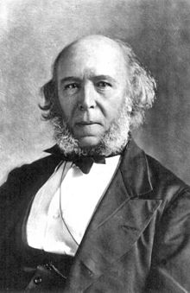
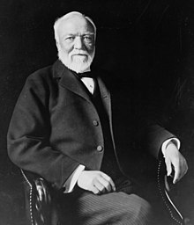
Key Terms
Social Darwinism:
  “Survival of the fittest” applied to businesses
  Used to justify the success of businesses and the wealthy
Gospel of Wealth: (Andrew Carnegie)
  Advocated for wealthy individuals to give back to society (philanthropy)
    Examples: Vanderbilt University, Carnegie gave $ for libraries

Slide 11

Key Terms
Social Gospel:
  Protestant Church movement to improve society - created reading rooms, nurseries, and other services for needy
Interstate Commerce Act (1887):
  Allowed the government to investigate RRs, mostly symbolic at first
Sherman Anti-Trust Act (1890):
  Federal government could investigate trusts, strengthened in the 1900s

Slide 12
Test Tips
Multiple-Choice and Short Answer:
  Reasons for the creation and impacts of:
    Unions, consolidation of businesses, and Populist Party
  Differences between Republicans and Democrats (Currency and Tariffs)
Essays and DBQs:
  Impact of technology on workers/businesses

Slide 13
Thanks For Watching!
Best of luck in May!

