Slide 1


APUSH Review: Video #29: Manifest Destiny & Trade With Asia (Key Concepts 5.1, I, A-B, E)
Shoutout to Mr. White’s Class at the American School in Switzerland. Thanks for the support!
Everything You Need To Know About Manifest Destiny To Succeed In APUSH
www.APUSHReview.com

Slide 2
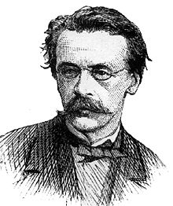
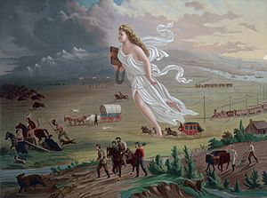
Manifest Destiny: An Intro
What is it?
  Belief that it was America’s “God-Given” right to expand from coast to coast
  Term was created by John O’Sullivan
What time period is associated with it?
  1840s and 1850s
  Roots in the LA Purchase
Key Associations:
  Oregon
  Texas
  Mexican-American War

Slide 3
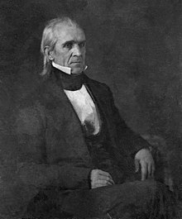
Oregon Territory
At one time, 4 countries claimed Oregon:
  Spain
  Britain
  Russia
  US
Boundary was NOT settled between US and Britain
James K. Polk campaigned on “5440’ or Fight”
Eventually, the US and Britain settled on the 49th parallel

Slide 4
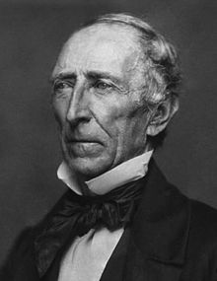
Texas
1836: Texas declared independence from Mexico
1844: presidential campaign focused on Texas
1845, under President John Tyler, Texas was annexed by US
The boundary was NOT settled by US and Mexico…

Slide 5
Mexican-American War
Causes:
  Texas boundary dispute
  “American blood on American Soil”
Effects:
  US gains the Mexican Cession
  US owns land from Atlantic to Pacific
  Debates over whether this land would be free or slave
Wilmot Proviso: proposed all acquired land would be free

Slide 6
Impacts of Manifest Destiny
Native Americans:
  Lost land and were pushed further west
  Eventually, many were forced to reservations
Slavery:
  #1 issue prior to the Civil War
  Debate over whether land should be free or slave
Westward Expansion
Debates Over Slavery

Slide 7
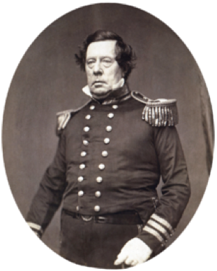
Interactions With Asia
US sought to trade with Asia
  Matthew Perry and the “opening” of Japan
  Clipper ships allowed for increased and faster trade
  Missionaries were established in China to spread Christianity

Slide 8
Quick Recap
Manifest Destiny
  What is it?
  When was it?
Oregon Territory
Texas Annexation
Mexican American War
Impacts of Manifest Destiny
Trade with Asia

Slide 9

Thanks For Watching!
Best of luck in May!

