Slide 1

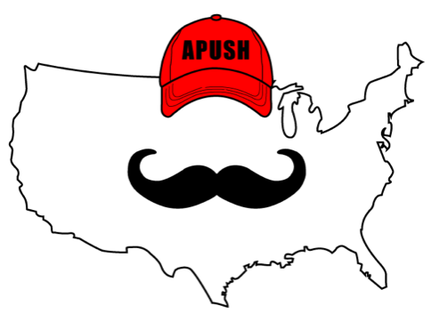
APUSH Review: Video #30 The Mexican American War (Key Concept 5.1, I, C)
Shoutout to Mrs. McDougall’s Class in Santa Cruz. Best of luck!
Everything You Need To Know About The Mexican-American War To Succeed In APUSH
www.APUSHReview.com

Slide 2
Events Leading To The War
Election of 1844:
  Clay (Whig) vs. Polk (Democrat)
  Polk embraced Manifest Destiny and the annexation of Texas, wins the election
Slidell Mission:
  Polk wanted to purchase CA and settle boundary dispute along TX border
April 25, 1846 - Mexico attacks US troops on “US” soil
  Spot Resolutions

Slide 3
An Important Battle And A Treaty
Battle of Buena Vista
  General Zachary Taylor becomes a hero, president in 1848
Treaty of Guadalupe Hidalgo:
  US gained California and modern-day NM, AZ, UT, and NV - 1/2 of Mexican territory
  US paid $15 million

Slide 4
Effects Of The War
America increased its size by 1/3
Future leaders emerge
  Taylor, Grant, Lee
Debates over slavery
  Wilmot Proviso
  Compromise of 1850 (more in future video)

Slide 5

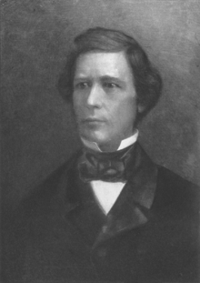
Wilmot Proviso
“Provided, That, as an express and fundamental condition to the acquisition of any territory from the Republic of Mexico by the United States, by virtue of any treaty which may be negotiated between them, and to the use by the Executive of the moneys herein appropriated, neither slavery nor involuntary servitude shall ever exist in any part of said territory, except for crime, whereof the party shall first be duly convicted.”

Slide 6
Gadsden Purchase
US purchased territory below the Mexican Cession
  Hopes of building a RR
Watch Jimmy Fallon’s “Gadsden Purchase”

Slide 7
Quick Recap
Election of 1844
Slidell Mission
Spot Resolutions
Effects of the war - debates over slavery
  GREAT essay topic
Wilmot Proviso
Gadsden Purchase

Slide 8
See You Back Here For Video #31: Nativism
Thanks for watching
Best of luck!

