Slide 1

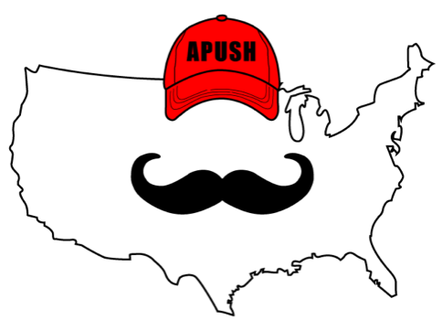
APUSH Review: Video #31: Nativism (Key Concepts 5.1, II, A - B)
Everything You Need To Know About Nativism To Succeed In APUSH
Shoutout to Mr. Lindstrom’s class. Good luck!
www.APUSHReview.com

Slide 2

Immigration
Immigrants from Asia settled on the West Coast
  Chinese in the 1850s
    Worked in gold mines, factories, RRs, and farming
    Later, the Chinese Exclusion Act (1882) forbid Chinese immigrants

Slide 3
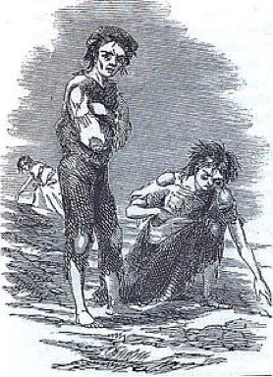
Immigration
European Immigrants:
  Irish - settled in the Northeast - mostly Catholic
  Germans - settled on the “frontier” - Midwest - as farmers
  Many immigrant children attended parochial schools

Slide 4
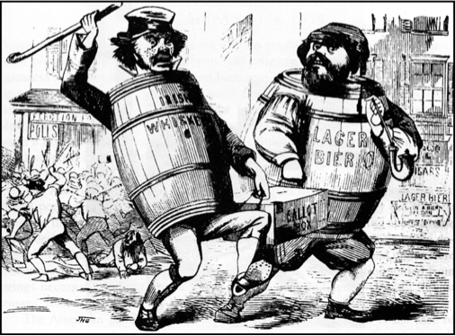
Nativism
What is it?
  Fear, distrust, dislike of foreigners
  Often anti-Catholic
Nativist groups sought to limit immigrants’ political power

Slide 5
Know-Nothing Party
What is it?
  Political Party that formed due to Nativism
Originated as the Supreme Order of the Star Spangled Banner
  Wanted to ban Catholics from holding offices
  Called for tough immigration and naturalization laws
In 1856, Ex-President Millard Fillmore ran for president for the Know-Nothing Party
  Won 21% of the popular vote

Slide 6
Quick Recap
Immigrant groups
Where did they settle
Nativism
Know-Nothing Party

Slide 7
See You Back Here For Video #32: Attempts To Resolve Slavery In The Territories
Thanks for watching
Best of luck!

