Slide 1
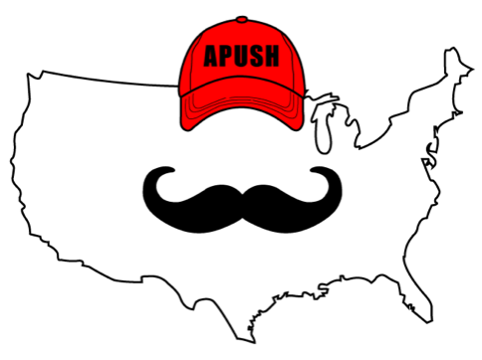
APUSH Review: Video #33: The End Of The Second Party System And The Election Of 1860 (Key Concept 5.2, II, C-D)
Everything You Need To Know About The End Of The Second Party System And The Election Of 1860 To Succeed In APUSH
www.APUSHReview.com

Slide 2
The End Of The Second Party System
With the passing of prominent Whig leaders, the party declined
Henry Clay and Daniel Webster
Slavery and nativism also weakened the parties
Emergence of sectional parties, especially the Republican Party

Slide 3
The Republican Party
Emerged in the North after the KS-NB Act
Sought to keep slavery from expanding (Free Soil)
First Republican president was Abraham Lincoln

Slide 4
Election of 1860
4 Candidates:
Abe Lincoln - Republican
John C. Breckinridge - Democrat
Stephen Douglas - Democrat
John Bell - Constitutional Union
Douglas and Breckinridge split the Democratic votes

Slide 5
Lincoln’s Victory
Lincoln campaigned on a Free Soil platform
He did not win a single Southern state

Slide 6
Impact Of The Election Of 1860
Southern states debated secession
December, 1860:
South Carolina seceded
Other states soon followed
Immediate cause of the Civil War
Began on April 12, 1861

Slide 7
Quick Recap
Reasons for decline of 2nd Party System
Republican Party - Free Soil
Candidates in 1860
Secession after Lincoln’s victory

Slide 8
See You Back Here For Video #34: The Civil War
Thanks for watching
Best of luck!

