Slide 1
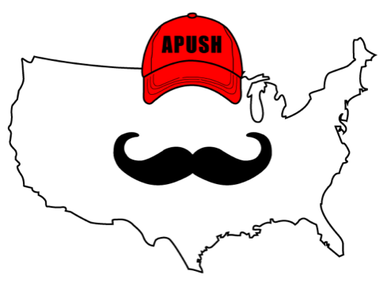
APUSH Review: Video #34: The Civil War (Key Concept 5.3, I, A-D)
Shoutout to Coach Mayr’s class in Georgia. Best of luck this year!
Everything You Need To Know About The Civil War To Succeed In APUSH
www.APUSHReview.com

Slide 2
Causes of the War (Historical Context)
Long-term:
Expansion of slavery
Uncle Tom’s Cabin
Popular Sovereignty
Short-term:
Election of 1860
Lincoln sought to keep slavery from expanding (Free-Soil)

Slide 3
Beginning Of The War
April 12, 1861:
Attack on Fort Sumter (South Carolina)
Both the North (Union) and South (Confederacy) mobilized their economies and societies
Conscription (Draft) was instituted in both regions
Could pay $ for a replacement

Slide 4
Beginning Of The War
Opposition persisted in both regions:
North:
Maryland newspapers were shut down by Lincoln
NYC Draft Riots - “rich man’s war, but a poor man’s fight”
South:
Many farmers refused to fight, would not let slaves fight

Slide 5
Border States
What were they?
Slave states that did NOT secede during the Civil War
Which states did this include?
Missouri, Kentucky, Maryland Delaware, and West Virginia (later)
Their siding with the Union was a major factor in the outcome of the war

Slide 6
Lincoln’s Goals
In the beginning, the war was fought to preserve the Union
September 22, 1862 - Emancipation Proclamation:
Declared that all slaves in areas of REBELLION would be free
Helped change the purpose of the war
Kept European countries from supporting the Confederacy
Slavery was banned in Europe, Europeans would not support the Confederacy
Many African Americans enlisted in the Union Army
Fought in segregated units, paid less than whites

Slide 7
Gettysburg Address
Issued in 1863
Civil War goals changed from preserving the Union to ending slavery
Referenced a “new birth of freedom” - sought to ensure that all men are truly equal

Slide 8
Why Did The Union Prevail?
Improvements in leadership and strategy:
Sherman and Grant
Anaconda Plan - blockade of the South
Key Victories:
Antietam - tie, strategic victory for the North (morale boost, kept Europe out of the war)
Emancipation Proclamation was issued after this battle
Gettysburg - issuance of the Gettysburg Address

Slide 9
Why Did The Union Prevail?
Greater Resources:
Larger population and more factories
Destruction of the South’s infrastructure:
Sherman’s “March to the Sea”

Slide 10
Personal Liberties During The War
Habeas Corpus:
Cannot be held in jail without charges brought against you
Lincoln suspended Habeas Corpus
Only Congress can suspend Habeas Corpus
Ex Parte Merryman (1861)
Supreme Court ruled the President could not suspend Habeas Corpus, Lincoln ignored the decision

Slide 11
African Americans During The War
Beginning in 1862, African Americans could enlist in the war
54th Regiment
“Glory”
Fought in segregated units
Often did manual labor
Paid less than whites

Slide 12
Women During The War
Employment opportunities increased:
Teachers, factories, nursing
National Women’s Loyal League:
Elizabeth Cady Stanton and Susan B. Anthony
Hoped to abolish slavery and gain female suffrage
Clara Barton:
Helped distribute medical supplies during the war
Later founded the Red Cross

Slide 13
Quick Recap
Long-term and short-term causes of the war
Mobilization of economies
Opposition to the war
Importance of Border States
Lincoln’s evolving purpose of the war
Emancipation Proclamation and Gettysburg Address
Reasons for Union Victory
Personal liberties during the war
African Americans during the war
Women during the war

Slide 14
See You Back Here For Video #35: Reconstruction
Thanks for watching
Best of luck!

