Slide 1
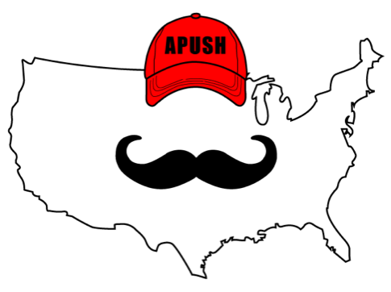
APUSH Review: Video #36: The Government & Economy During The Post-Civil War Period (Key Concept 6.1, I, A - C, E)
Everything You Need To Know About The Government & Economy During The Post-Civil War Period To Succeed In APUSH
www.APUSHReview.com

Slide 2

Government & The Economy DURING the Civil War
Homestead Act (1862):
  Open to any adult who never took up arms against the United States
  Gave 160 acres of land free to anyone that lived on the land for 5 years
Morrill Land Grant Act (1862):
  Encouraged states to use $ from land sales to support agricultural and technical colleges
    Cornell University in NY

Slide 3
Government & The Economy DURING the Civil War
Government provided $ and land for construction of RRs
  Pacific Railway Act (1862):
    Provided for the construction of a Northern transcontinental RR and telegraph line to link California with the East
May, 1869, the transcontinental RR was complete
Impact of subsidies?
  Growth of farms, cities, and lumber industry

Slide 4
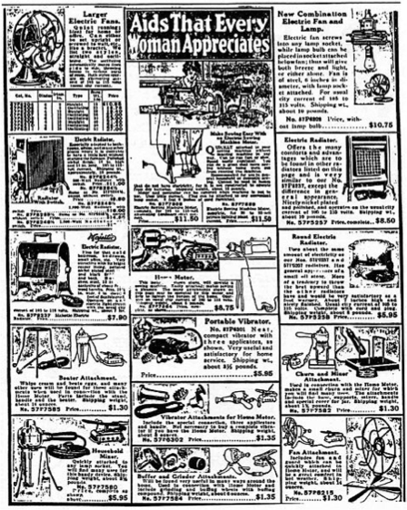
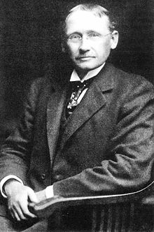
Causes Of Increased Production Of Goods By Businesses
Technological advances:
  “Taylorism” - Frederick Taylor - focused on improving efficiency - timed tasks, specific tasks for workers
Greater access to natural resources
  Lumber out west
Redesigned financial and management structures
  Monopolies - businesses sought to have sole control over an industry
Marketing advances
  Mail order catalogs - Sears
Growing labor force
  Large supply of workers, including immigrants

Slide 5
Impacts Of This Growing Economy?
Price of goods decreased
  Larger supply of goods, cheaper production
Increase in workers’ wages
  More $ for workers to spend
Increased standard of living
New access to goods and services
  Sewing machines, sporting equipment, household items
However, there was a growing gap between the rich and poor

Slide 6
Looking Outside The US
Businesses sought markets and resources in other areas of the world
  Pacific Rim:
    Hawaii - calls for annexation in the 1890s (sugar plantations)
  Asia:
    Philippines - gained in 1898 (Spanish-American War)
    Open Door policy (1899)
      US sought to trade freely with China
        China was divided into Spheres of Influence - US was afraid of being left out

Slide 7
Looking Outside The US
Latin America:
  “Big Brother Policy” - James G. Blaine, 1890s
    US hoped to open up markets for businesses in Latin America

Slide 8
Quick Recap
How did the government encourage expansion?
Causes of increased production:
  Technological innovations, Financial and management structures, Marketing, Growing labor force
Impacts of growing economy?
  Price of goods decreased, Wages increased, New access to goods, Growing gap between rich and poor
Why and where did businesses look outside the US?
  Asia, Pacific Rim, Latin America

Slide 9
See You Back Here For Video #37: Laissez-faire, The Industrial Workforce, And The “New South” (Key Concept 6.1, II, A - B, D)
Thanks for watching
Best of luck!

