Slide 1
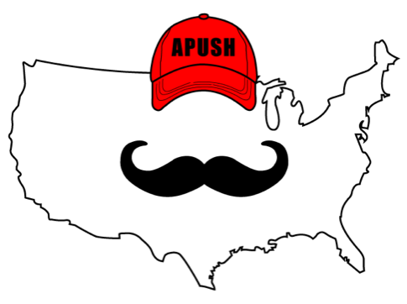
APUSH Review: Video #40: Transcontinental RRs and Westward Settlement, And Native Americans (Key Concept 6.2, II, A - E)
Everything You Need To Know About Transcontinental RRs and Westward Settlement To Succeed In APUSH
www.APUSHReview.com

Slide 2
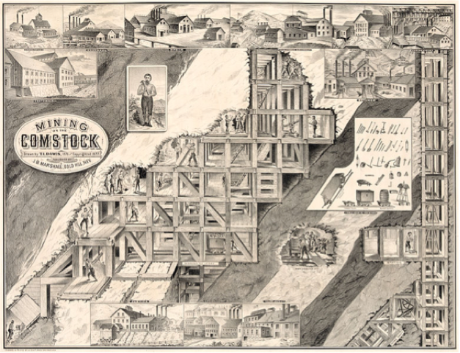
Reasons For Westward Migration
Transcontinental RRs:
  Often built by the Irish and Chinese
  RRs were given government subsidies
  Encouraged westward settlement
Mineral Resources:
  Comstock Lode - present-day Nevada
    Led to a silver rush
Government policies:
  Homestead Act (160 acres of land)
  Pacific Railway Act
These created new communities and centers of commercial activity

Slide 3
Westward Migration
Many migrants moved to rural and boomtown areas of the West
  Hoped to achieve self-sufficiency
    “Safety-valve” theory:
      Idea that one could always move west and make $ during tough economic times
  Economic opportunities:
    Building RRs, mining, farming, ranching
      Teddy Roosevelt in the 1880s

Slide 4
Impacts Of Western Migration
Bison population decreased drastically
Competition for land between Whites, Natives, and Mexican Americans
  Sioux Wars (1866):
    Result of gold discovery in South Dakota
    Battle of Little Bighorn (Custer’s Last Stand)
      Victory for Natives as Custer and his men were killed

Slide 5
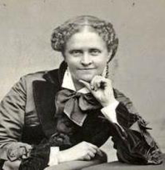
A Century Of Dishonor
Written by Helen Hunt Jackson in 1881
Chronicled a 100 year period of unfair treatment of Natives by the US government

Slide 6
US Government Interaction With Natives
The US often violated treaties with Natives
  Indian Appropriation Act of 1871:
    Ended tribal recognition as independent nations - nullified previous treaties
Would use military force to resistance
  Battle of Wounded Knee - 1890 - 300 Natives were killed (women and children)
Most Natives were moved to reservations
  Loss of sovereignty

Slide 7
Natives Seek To Preserve Autonomy
US promoted policies of assimilation
  Dawes Act (1887):
    Sent Native children to boarding schools, had to speak English
    Native families were given individual plots of land
      Hunting to farming
Natives practiced the Ghost Dance:
  Ceremony in which Natives envisioned the return of bison and elimination of whites

Slide 8
Quick Recap
3 reasons for westward expansion
Safety-valve theory
Opportunities out west
Conflicts between US and Natives
Helen Hunt Jackson
Dawes Act and assimilation

Slide 9
See You Back Here For Video #41: Social Darwinism And Criticisms Of Capitalism
Thanks for watching
Best of luck!

