Slide 1

APUSH Review: Video #41: Social Darwinism And Criticisms Of Capitalism (Key Concept 6.3, I, A - C)
Everything You Need To Know About Social Darwinism And Criticisms Of Capitalism To Succeed In APUSH
www.APUSHReview.com

Slide 2
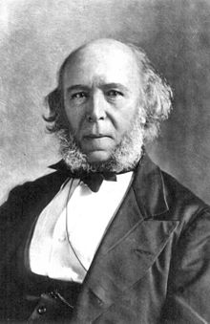
Social Darwinism
What is it?
  “Survival of the fittest” applied to humans and businesses
  Advocated for businesses to use any tactics to prosper
Why was it used?
  To justify the success of the wealthy - appropriate and inevitable for the wealthy to succeed

Slide 3
Gospel Of Wealth
Some argued that the wealthy had a responsibility to help those that are less fortunate
Andrew Carnegie’s Gospel of Wealth
  Argued that the wealthy should give back to society (philanthropy)
Examples of philanthropy:
  Carnegie gave $ for 100s of libraries throughout the US
  Vanderbilt University - $1 million from Cornelius Vanderbilt

Slide 4
Alternative Visions For Society
Many groups began to champion alternative visions for the economy and society
Agrarians:
  Sought more government involvement in economy (Populists), advocated government ownership of railroads
  Coxey’s Army:
    Group that marched to Washington and demanded relief and government jobs

Slide 5
Alternative Visions For Society
Utopians:
  Oneida Community:
    Practiced communal ownership, free love, eugenics
Socialists:
  Society is more than the individual, promotes human welfare and elimination of class systems

Slide 6

Alternative Visions For Society
Advocates of the Social Gospel:
  Protestant Church movement to improve society
    Elimination of child labor, improve schools, fight poverty, etc.
Walter Rauschenbusch

Slide 7
Quick Recap
Social Darwinism - justification for wealth
Carnegie’s Gospel of Wealth
Alternative visions to society
  Agrarians
  Utopians
  Socialists
  Social Gospel

Slide 8
See You Back Here For Video #42: Political Parties, Jane Addams, and Plessy v. Ferguson
Thanks for watching
Best of luck!

