Slide 1
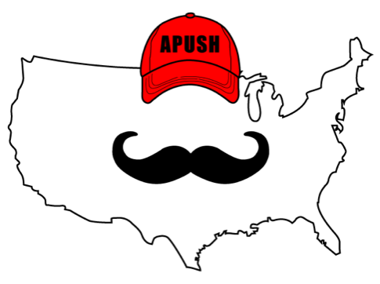
APUSH Review: Video #42: Political Parties, Jane Addams, & Plessy v. Ferguson (Key Concept 6.3, II, A - C)
Everything You Need To Know About Political Parties, Jane Addams, & Plessy v. Ferguson To Succeed In APUSH
www.APUSHReview.com

Slide 2
Political Parties In The Late-19th Century
Democrats:
  Gained support from the “Solid South”
Republicans:
  Tended to receive their support in the North

Slide 3
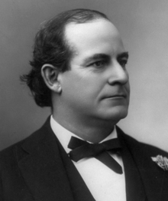
Political Party Differences
Tariffs:
  Republicans advocated raising tariffs (McKinley Tariff - 1890)
  Democrats favored lowering tariffs
Currency:
  Republicans favored the Gold Standard (McKinley - 1896)
  Democrats favored Free Silver (Bryan - 1896)
Reformers argued greed and self-interest corrupted all levels of government
  Local level - political machines
  Federal level - patronage and election of senators by state legislatures

Slide 4

Women In The Late-19th Century
Women sought greater equality with men by:
  Joining voluntary organizations:
    National American Woman Suffrage Association (NAWSA) - helped lead to the passage of the 19th amendment in 1920
    Women’s Christian Temperance Union (WCTU) - supported the 18th amendment
  Going to college:
    New women’s colleges emerged during this time

Slide 5
Women In The Late-19th Century
Women sought greater equality with men by:
  Promoting social and political reform:
    Elizabeth Cady Stanton - leading suffragist, advocate of interracial marriage
  Working in settlement houses to help immigrants:
    Jane Addams and the Hull House (Chicago)
      Helped immigrants assimilate to society
      Inspired other settlement houses

Slide 6
Plessy v. Ferguson (1896)
Supreme Court decision that upheld Jim Crow laws in the South
  “Separate but equal”
  With other laws/court cases during this time, the 13 - 15 amendments were severely limited
  Later overturned by Brown v. Board (1954)

Slide 7
African American Reformers
Fought for political and social equality in light of:
  Violence - Ida B. Wells
    Journalist, outspoken critic of lynching, advocated for a federal anti-lynching law
  Discrimination - Booker T. Washington
    Advocated vocational training for African Americans
  Scientific theories of race - some anthropologists argued that African Americans were inferior to whites - used skull measurements

Slide 8
Quick Recap
Differences between Republicans and Democrats
  Currency
  Tariffs
Voluntary Organizations joined by women
Jane Addams and the Hull House
Plessy v. Ferguson

Slide 9
See You Back Here For Video #43: The Gilded Age
Thanks for watching
Best of luck

