Slide 1
APUSH Review: The 1920s
Everything You Need To Know About The 1920s To Succeed In APUSH

Slide 2
Pre-1920s
Progressive Era:
1890s - 1920
Government regulation/involvement in the economy
WWI:
US entered in 1917 - Zimmermann Note, German unrestricted submarine warfare
Restriction on freedom of speech - upheld by Schenck v. US (1919)
1st Red Scare 1919-1920:
Caused by: Russian Revolution, radical ideas, immigration
Unions and immigrants were associated with radical ideas and communism
Sacco and Vanzetti

Slide 3
Election of 1920
Warren G…… Harding (R) vs. James Cox (D)
Harding campaigned on a “Return to Normalcy”
Reverting to isolationism/neutrality and less government involvement (laissez-fare)
Essentially, turning away from the Progressive Era
Harding wins in a landslide, 404 - 127
Republicans would hold the presidency until the Election of 1932

Slide 4
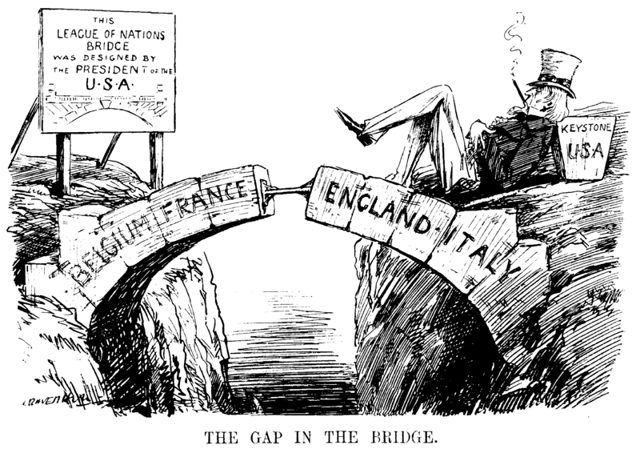
US Foreign Policy In The 1920s
Defeat of the Treaty of Versailles
Article X
The US did NOT join the League of Nations
US relations with other countries?
Unilateral foreign policy - one sided - pursue own interests
Select military intervention
Mostly in Latin America - Nicaragua (1912 - 1938)
International investment:
Continuation of Dollar Diplomacy
The US maintained isolationism

Slide 5
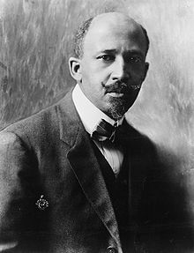
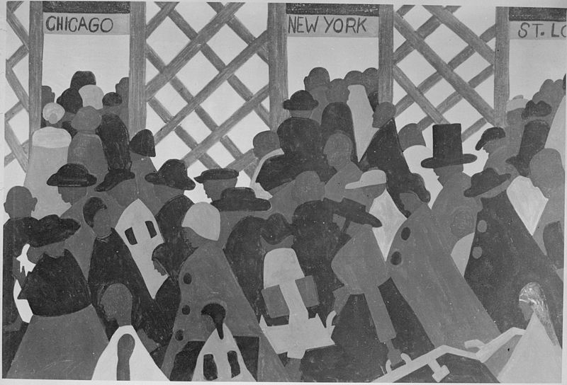
Social Issues Of The 1920s
This country of ours, despite all its better should have done and dreamed, is yet a shameful land…..
We return.
We return from fighting.
We return fighting.
1st Great Migration (During and after WWI)
African Americans left the south due to:
Segregation (Jim Crow)
Racial violence (lynchings)
Limited economic opportunities (sharecropping)
Moved to the North and West
Found economic opportunities, but still faced discrimination
Lower-paying jobs- janitors, dishwashers, etc.
Red Summer (1919) - race riots in many northern cities (Chicago)

Slide 6
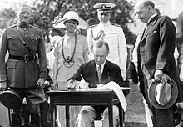
Social Issues Of The 1920s
Immigration:
Emergency Quota Act of 1921:
Restricted # of immigrants from a country to 3% of total people from that country living in the US in 1910
National Origins Act of 1924:
Quota was cut from 3% to 2%, used 1890 census
Both these acts put an end to UNRESTRICTED immigration
Sacco and Vanzetti:
Two Italian immigrants that were charged with robbery and murder
They were anarchists, atheists, and draft dodgers
Their trial focused on their beliefs more than the evidence
Both were executed in 1927

Slide 7
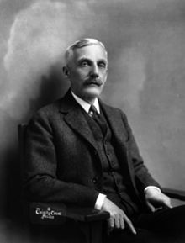
The 1920s Economy
The government took a laissez-faire approach
Secretary of Treasury Andrew Mellon’s tax cuts for wealthy
Similar to Reagan’s and George W. Bush’s tax plans
Farmers:
Production continually outweighed demand - lower crop prices
The stock market experienced a Bull market for much of the decade
Stock Market Crash - October 29, 1929 (Black Tuesday)
Start of the Depression
Banks closed throughout the early 1930s
“The business of government is business.”

Slide 8
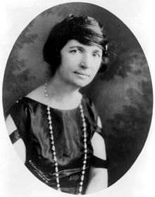
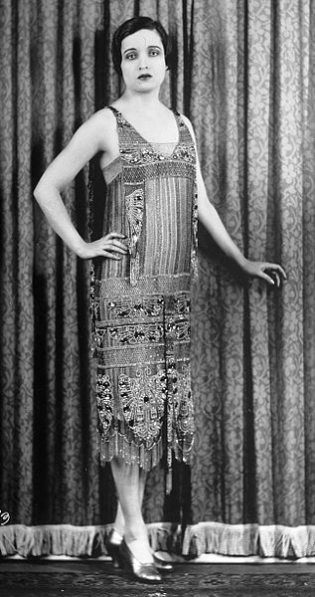
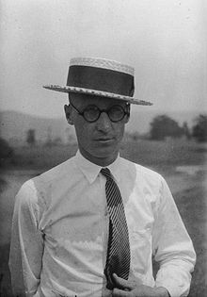
Cultural Issues Of The 1920s
Gender Roles:
“Flappers” challenged gender norms
Women that drank, danced, smoked, and wore shorter dresses
Margaret Sanger advocated birth control
Proposed Equal Rights Amendment (come back to in 1972)
Modernism:
1920 census - more Americans living in cities for 1st time
Many workers lost autonomy - Scientific Management and the assembly line
Science vs. religion:
John Scopes Trial
Teaching of evolution in a TN school
Literal interpretation of the bible vs. evolution

Slide 9
Technology Of The 1920s
Radio:
HUGE source of entertainment (War of the Worlds - 1938, soap operas, “Fireside Chats”)
Cinema:
Motion pictures became more popular - “Nickelodeons”
Movies would entertain many during the Great Depression
The Jazz Singer - 1st movie with sound
Automobiles:
Mass-production popularized by Henry Ford
Allowed for vacations (personal mobility), and later the growth of suburbs

Slide 10
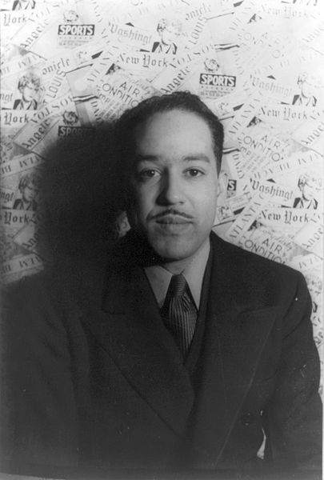
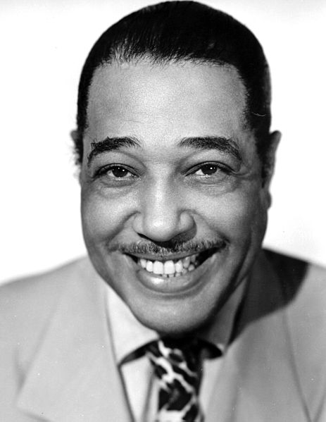
The Harlem Renaissance
“The night is beautiful,
So the faces of my people.
The stars are beautiful,
So the eyes of my people.
Beautiful, also, is the sun.
Beautiful, also, are the souls of my people.”
What was it?
A celebration of African American culture through writing, music, and art
Many African Americans flocked to Harlem during the 1920s from the South (Great Migration)
Key Harlem Renaissance Figures:
Langston Hughes
Zora Neale Hurston - author
Duke Ellington - Jazz musician

Slide 11
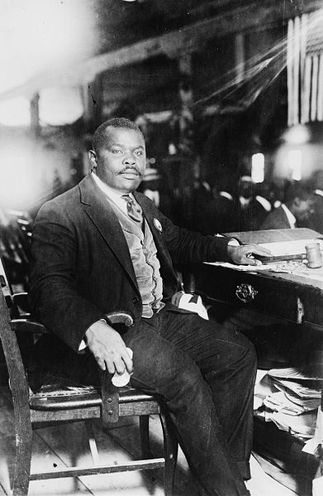
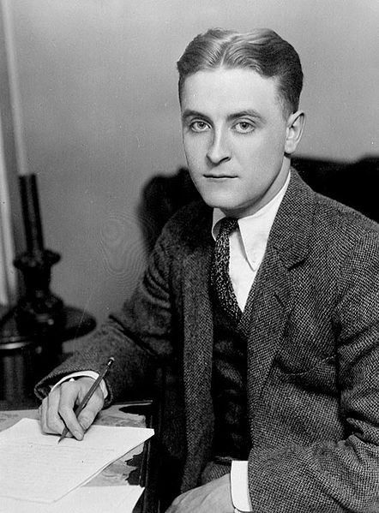
Other 1920s Info
“Lost” Generation
Group of writers that criticized 1920s culture and materialism
F. Scott Fitzgerald, T.S. Eliot, James Joyce, etc
Similar to the Beat Generation of the 1950s
Marcus Garvey:
Advocated Black Nationalism
Founded the Universal Negro Improvement Association (UNIA)
Promoted a Back-to-Africa movement
Inspired Malcom X
KKK:
Reaction to “New” Immigrants and Birth of a Nation
In addition to targeting African Americans, the KKK targeted immigrants, Jews, and Catholics

Slide 12
Test Tips
Multiple-Choice and Short Answer:
Causes and effects of:
1st Red Scare
Great Migration
Nativism and Immigration Quotas
Harlem Renaissance
Essays:
Comparing and Contrasting the 1920s and 1950s
Red Scares, Post-World Wars, Culture, etc.

Slide 13
Thanks For Watching!
Check Out My Decades Playlist
Best of luck on all your exams!

