Slide 1
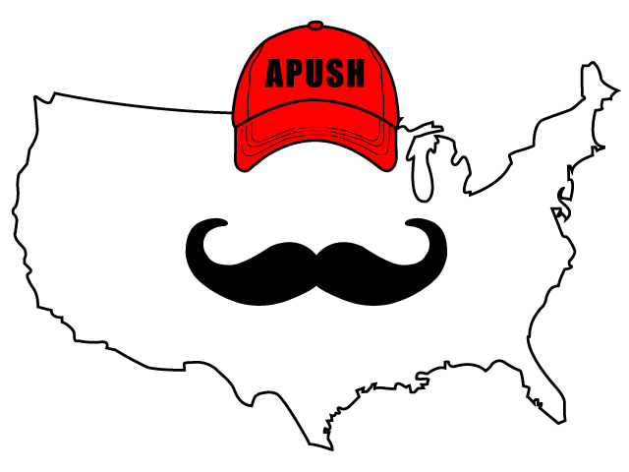
APUSH Review: The New Deal (Updated)
Everything You Need To Know About The New Deal To Succeed In APUSH

Slide 2
Big Ideas BEFORE The New Deal
Laissez-Faire of the 1920s
Stock Market Crash of 1929
Bonus Army
Roughly 1/4 of banks failed prior to FDR becoming President

Slide 3
FDR’s First Few Days In Office
March 4, 1933 - Inauguration
National Bank Holiday
Closed banks for several days
Emergency Banking Relief Act
President could reopen “good” banks
Fireside Chats
Radio addresses to help restore public faith in banks

Slide 4
FDR’s New Deal
“Attempted to end the Great Depression by using government power to provide RELIEF to the poor, stimulate RECOVERY, and REFORM the American economy.”
7.1, III, A - page 76

Slide 5
Two New Deals
1st New Deal (1933 - 1935)
Focused primarily on RELIEF and RECOVERY
2nd New Deal (1935 - 1938)
Focused primarily on REFORM and changing the role of the government

Slide 6
Relief
Goal was to provide jobs, help end suffering (Short Term)
Examples of Programs
Civilian Conservation Corps (CCC)
Put young men (18 - 24) to work
Workers sent a portion of their income back to families
Environmental work: planting trees, building parks, etc.
Worked in segregated camps

Slide 7
More Relief Programs
Public Works Association (PWA):
Provided $4 billion to state governments to build schools, roads, highways, etc.
Works Progress Administration (WPA)
Employed 9 million workers
Built roads, bridges, etc.

Slide 8
Recovery
Goal was to help improve the economy
Agricultural Adjustment Act (AAA)
Sought to limit the production of crops
Paid farmers NOT to grow crops
Overturned in Butler v. US

Slide 9
More Recovery
National Industrial Recovery Act (NIRA)
Allowed the president to set codes for industries (prices, working hours, etc.)
Declared unconstitutional in Schechter Poultry v. US

Slide 10
Reform
Goal was to reform the economy, prevent another Great Depression
Federal Deposit Insurance Corporation (FDIC)
Guaranteed bank deposits up to $5,000
Helped restore faith in banks
Securities and Exchange Commission (SEC)
Sought to protect the stock market from fraud

Slide 11
More Reform
Social Security:
Provided unemployment insurance
Pensions for retired workers

Slide 12
How To Pay For Most Of These Programs?
Deficit Spending - spending more than the government brings in
“Priming the pump”
John Maynard Keynes
Economist that influenced FDR

Slide 13
People That Pushed Roosevelt Towards More Change
Dr. Francis Townsend - pension plan influenced the creation of Social Security
Huey Long - proposed providing $5,000 to every family by taxing the wealthy

Slide 14
Groups That Sought To Limit The New Deal’s Scope
Supreme Court:
Declared the AAA and NRA unconstitutional
Conservatives in Congress:
Robert Taft (R - Ohio) and some Conservative Democrats sought to limit the New deal
Democrats lost House seats in 1938

Slide 15
Court Packing Plan
After several New Deal programs were declared unconstitutional, FDR sought to influence the Supreme Court
His plan?
For every judge over 70 that does not retire, he could appoint a new one
This would allow him to appoint up to six new judges
This NEVER happened due to public outcry

Slide 16
Native Americans And The New Deal
Indian Reorganization Act (1934):
Essentially reversed the Dawes Act of 1887 which encouraged individuals to own land
This sought to have tribes collectively own land
John Collier - Commissioner of Indian Affairs

Slide 17
African Americans And The New Deal
By 1935, 1/4 of African Americans were receiving government assistance
Roosevelt did not push to make lynching a federal crime or end poll taxes
Segregation existed within the CCC
Relief agencies paid African Americans and other minority groups less than whites in certain areas
In 1936, African Americans overwhelmingly voted for Roosevelt and Democrats

Slide 18
Women And The New Deal
Frances Perkins became the first female Cabinet member
Eleanor Roosevelt was his “eyes and ears”
Most women did not receive government jobs
Belief that in economic downturns, men, not women, should have the most jobs

Slide 19
Impacts of the New Deal
Did not end the Depression
Reforms are still around today:
Social Security, FDIC, SEC, etc.
Political Realignment:
African Americans and working class communities supported the Democratic Party in large numbers

Slide 20
Positives And Negatives Of New Deal
Positives
Negatives
Restored faith and optimism (especially in banking system)
Provided millions of jobs
Programs still exist today (Social Security, FDIC, etc.)
Unemployment still persisted throughout the 1930s
WWII helped end the depression
Did not address segregation/discrimination

Slide 21
Test Tips
Multiple-Choice and Short Answer:
Groups that sought to expand or limit the New Deal
Political realignment of New Deal
Short Answer on two interpretations of the New Deal
Essays:
Comparing the New Deal with another time period (Progressive Era, Great Society)
Analyzing the extent to which the New Deal fostered change

Slide 22
Thanks For Watching!
Best of luck in May!

