Slide 1
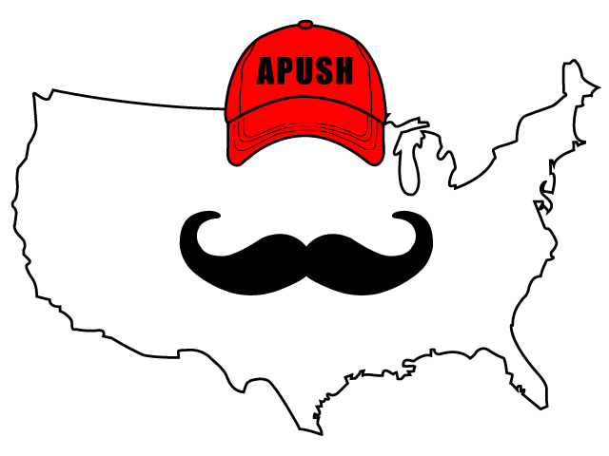
APUSH Review: The Progressive Era (Updated)
Everything You Need To Know About The Progressive Era To Succeed In APUSH

Slide 2
The Progressive Era: A Brief Intro
Early 20th Century - 1920
Reasons for the emergence of this era:
Political corruption
Economic instability
Social Concerns
How to fix these issues?
Increased government action

Slide 3
Characteristics of Progressives
Middle and Upper Class
Many women
Favored expanding democracy
17th amendment - direct election of senators
19th amendment - Women’s Suffrage
State and Local Levels
Initiative - individuals can propose laws
Referendum - individuals can vote on laws
Recall - individuals can remove an elected official

Slide 4
Key Progressive Journalists
Criticized:
Political Corruption:
Lincoln Steffens’ The Shame of Cities
Social and Economic Inequality:
Jacob Riis’ How The Other Half Lives
Ida B. Wells-Barnett - advocated an end to lynching
Upton Sinclair’s The Jungle

Slide 5
Key Progressive Reformers
Robert La Follette:
Governor of Wisconsin
Direct primary, initiative, referendum, and recall (Wisconsin Idea)
Jane Addams:
Founder of the Hull House
Aided women, children, and immigrants

Slide 6
Key Progressive Reformers
Florence Kelley:
Advocated increased rights for women, children, and African Americans
National Consumer League
Led boycotts of goods made by children
W.E.B. DuBois:
Demanded immediate end to segregation
Helped form the NAACP

Slide 7
The Progressive Presidents
Roosevelt:
Square Deal - Consumer Protection
Meat Inspection Act
Corporate Regulation:
Northern Securities Decision
Hepburn Act - increased power of ICC
Conservation of Natural Resources

Slide 8
The Progressive Presidents
Taft was the real “Trust Buster”
Falling out with Roosevelt led to Roosevelt running for president in 1912
Wilson’s New Freedom:
Lower tariffs (Underwood Tariff)
Eliminate trusts (no distinction between “good” or “bad” trusts
Clayton Anti-Trust Act
Reform Banking System
Federal Reserve Act

Slide 9
Key Progressive Amendments
16th Amendment:
Graduated income tax
17th Amendment:
Direct election of senators
18th Amendment:
Prohibition of alcohol
19th Amendment:
Women’s suffrage
Connect to the Populists!

Slide 10
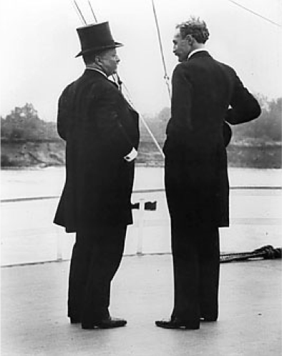
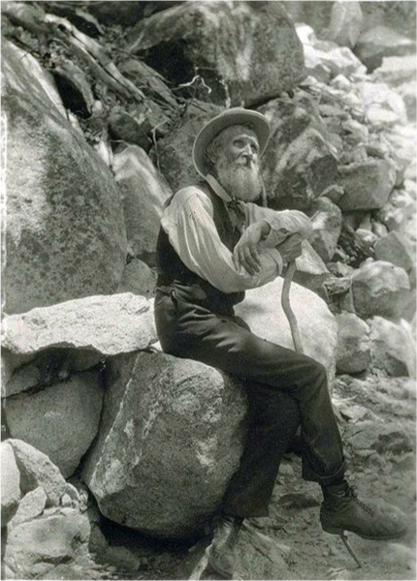
Conservation and Preservation
Conservation
Advocated the proper use of nature and resources
Teddy Roosevelt
Preservation:
Advocated the protection of nature and land from humans
John Muir and the Sierra Club

Slide 11
Test Tips
Multiple-Choice and Short Answer:
Characteristics and goals of Progressives
Excerpt from a book (Jungle, How The Other Half Lives, etc.)
Conservation vs. Preservation
Essays:
Analyzing the extent to which the Progressive Era fostered change for different groups/government
Comparing/Contrasting Progressives with Populists or another era

Slide 12
Thanks For Watching!
Best of luck in May!

