Slide 1
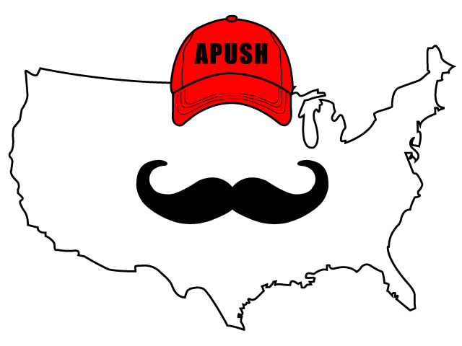
APUSH Review: Video #47: World War I (Key Concepts 7.2, II, B - C, 7.3, II, A - D)
Everything You Need To Know About WWI To Succeed In APUSH
Shoutout to Danielle and my mods 1 and 11 classes. You are the best!
www.APUSHReview.com

Slide 2
Background Info On WWI
Began on July 28, 1914
MAIN Causes:
Militarism
Alliances
Imperialism
Nationalism
Assassination of Archduke Franz Ferdinand was the immediate cause of the war
Allies: France, England, Russia (Later US)
Central Powers: Germany, Austria-Hungary, Italy

Slide 3
Beginning Of US Involvement
Initially the US was neutral:
Tradition of non-involvement in European affairs
Washington’s Farewell Address, Monroe Doctrine
Why did the US get involved?
Germany’s unrestricted submarine warfare
Zimmermann Note
Russian Revolution - Russia withdrew from the war
Woodrow Wilson’s “calls for the defense of humanitarian and democratic principles”

Slide 4
Impact Of US Involvement?
US entered the war in 1917 - almost three years after the war started
The American Expeditionary Forces (military) tipped the balance in favor of the allies
Led by General John J. Pershing - fought on the Western Front

Slide 5
The Homefront
Movement of Americans to cities:
War production by women and African Americans
Great Migration:
Mass movement of African Americans from the South to the North and west for jobs and to escape:
Segregation, racial violence, and limited economic opportunities
George Creel:
Journalist, helped drum up support for the war via 4 minute speeches

Slide 6
Civil Liberties
Espionage and Sedition Acts:
Espionage - made it illegal to try to incite rebellion or obstruct the draft
Sedition - Punished those that criticized the Government
Schenck v. US (1919)
Charles Schenck criticized and spoke out against the draft, was arrested
The Supreme Court upheld the Espionage Act
“Clear and present danger”
Remember, in times of war and crisis your rights decrease

Slide 7
Woodrow Wilson’s 14 Points
Goal was to prevent another war and avoid causes of WWI
Some of his points included:
No secret alliances
Freedom of the seas
Eliminate economic barriers (tariffs)
Reduce imperialism, promote self-determination
An “association of nations”
League of Nations

Slide 8
The Treaty Of Versailles
Germany was punished for its role:
Took away colonies, had to admit guilt for the war, pay reparations
The US Senate rejected the Treaty of Versailles:
Many senators feared the US would get involved in future wars without their consent
Washington’s Ghost

Slide 9
US Policy Post-WWI
US pursued a unilateral foreign policy that used:
International investment
Continuation of Dollar Diplomacy - US banks and businesses investing in foreign countries
Peace Treaties:
Washington Naval Conference (5 power and 9 power treaties) - determined the number of battleships the US, Britain, and Japan could build (5:5:3 ratio)
Select military interventions:
Mostly in Latin America - Nicaragua (1912 - 1933)
The US still sought to maintain isolationism
Neutrality Acts of the 1930s (more in a future video)

Slide 10
Quick Recap
Reasons for WWI
Reasons for US involvement in WWI
Impact of US involvement
Homefront during the war
Reduction of Civil Liberties - Schenck v. US (1919)
Great Migration
Wilson’s 14 Points
Rejection of the Treaty of Versailles
US policy post WWI

Slide 11
See You Back Here For Video #48: The 1920s
Thanks for watching
Best of luck!

