Slide 1
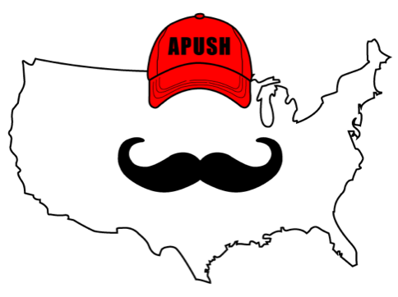
APUSH Review: Video #50: World War II (Key Concepts 7.3, II, E, 7.3, III, A - E)
Everything You Need To Know About World War II To Succeed In APUSH
www.APUSHReview.com

Slide 2
The 1930s
Americans were concerned with fascism and totalitarianism in Europe, but opposed military intervention
America First Committee - Isolationists (Charles Lindbergh)
Neutrality Acts (1935 - 1937):
US could not trade with belligerent (warring) nations
Did not matter who was the aggressor or who was the victim
US citizens could not travel on ships from warring nations

Slide 3
The 1930s
Panay Incident (1937):
Japan attacked a US ship
Led to FDR’s Quarantine Speech
Encouraged economic embargoes on aggressive nations
Munich Conference (1938):
Parts of Czechoslovakia were given to Germany; Hitler promised to not take more land
September 1, 1939:
Germany invaded Poland - official start of WWII

Slide 4
WWII - US Entrance
Lend-Lease Act (1941):
US could lend crucial supplies to countries the president deems vital (Great Britain)
December 7, 1941:
Japan attacks Pearl Harbor, US enters WWII

Slide 5
How Did Americans View The War?
Freedom and survival vs. fascism and militarism
Later reinforced by:
Japanese wartime atrocities:
Bataan Death March
Unbroken
Nazi concentration camps and the Holocaust:
11 million people, including 6 million Jews

Slide 6
Mass Mobilization
The war helped end the Great Depression and providing necessary equipment and supplies to the Allies

Slide 7
The Homefront
New opportunities for women and minorities:
“Rosie the Riveter” - millions of women worked in factories
Income increased
Mexican-Americans - increase in workers from Mexico via the Bracero Program

Slide 8
The Homefront
Debates over segregation:
US soldiers fought in segregated units
FDR’s Executive Order 8802
Banned segregation in defense industries
Japanese Internment:
Executive Order 9066
100,000 + Japanese-Americans on the West coast were moved to camps
2/3 were born in the US - native born citizens
Upheld by Korematsu v. US

Slide 9
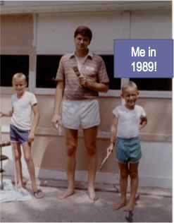
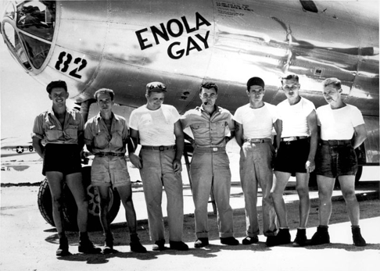
Why Did The Allies Win?
Military cooperation among allies:
Britain and the US
Technological and scientific advances
Manhattan Project - $2 billion to develop the atomic bomb
Atomic bombs ended the war, but sparked debates about their use

Slide 10
Impacts Of The War
Much of Asia and Europe laid in ruins
US and allies played a large role in postwar peace settlements
Japan
Nuremberg Trials in Germany
US emerged as the most powerful nation on earth

Slide 11
Quick Recap
Neutrality in the beginning:
American First Committee
Neutrality Acts
Pearl Harbor
War helped end the Great Depression
Opportunities for women and minorities
Reasons for Allied victory

Slide 12
See You Back Here For Video #51: The Cold War
Thanks for watching
Best of luck!

