Slide 1
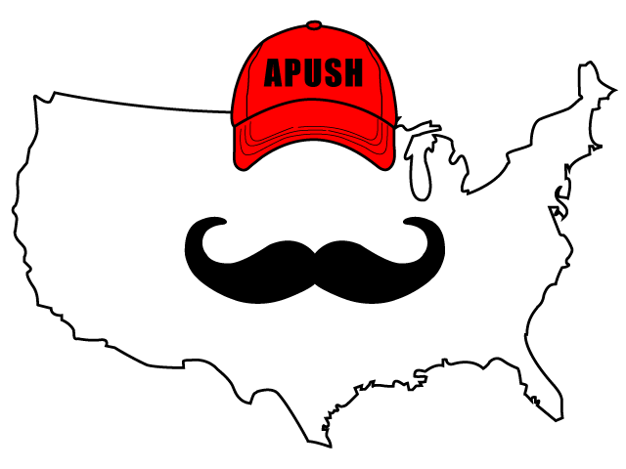
APUSH Review: Video #51: The Cold War (Key Concept 8.1, I, A-E)
Everything You Need To Know About The Cold War To Succeed In APUSH
www.APUSHReview.com

Slide 2
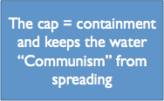
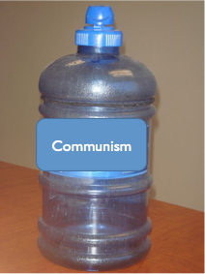
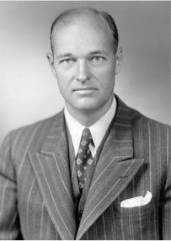
Origins Of The Cold War
With the end of WWII, differences between the US and USSR heightened
  “Is the enemy of your enemy your friend, or your enemy?”
The US sought to contain communism:
  George Kennan - father of containment
  The goal was to keep communism from spreading

Slide 3
The “Iron Curtain”
What was it?
  Fictional line that divided Communist Europe from non-Communist Europe
  Articulated by Winston Churchill in his famous speech in 1946

Slide 4
The US’ Foreign Policy
Based on:
  Collective Security:
    North Atlantic Treaty Organization (NATO) - an attack on one country was an attack on all
  International aid:
    Marshall Plan - provided billions of $ to Europe to rebuild war-torn nations
    Truman Doctrine - $400 million in military aid to Greece and Turkey
  Economic Institutions:
    International Monetary Fund (IMF) - created in 1944, promotes trade and provided loans to countries in need

Slide 5
How Did The US Hope To Contain Communism?
Military engagements in Korea and Vietnam (more in future videos)
  Domino theory - fear if one country fell to communism then surrounding countries would as well
Massive Retaliation:
  The US would respond with more force if attacked
  Ron Burgundy, “That escalated quickly”
Space Race:
  Reaction to the USSR launch of Sputnik and Yuri Gagarin
  US built up space program AND education

Slide 6
The Cold War: Military Confrontation and Detente
Military confrontation:
  Cuban Missile Crisis, October 1962
  Closest the US and USSR ever came to war
Detente - easing of tensions between the two Superpowers
  SALT (Strategic Arms Limitation Talks) -> Treaties:
    Began with Nixon’s administration and continued through Carter’s
    Agreements to limit certain arms

Slide 7
Postwar Decolonization
As many countries in Asia, Africa, and the Middle East became independent, the US and USSR sought allies among the new nations
  US immediately recognized Israel in 1948
  Many revolutions were seen as pawns of the Soviet Union
  Many of these countries remained non-aligned

Slide 8
The Cold War In Latin America
The “US would often support non-Communist regimes with varying levels of commitment to democracy”
  1954 - overthrew the elected Arbenz in Guatemala
  He was democratically elected and nationalized land owned by the United Fruit Company
  He was replace with a military dictator, Armas

Slide 9
Quick Recap
What is containment?
US foreign policy after WWII:
  Collective Security
  International Aid
  Economic Institutions
Cold War fluctuated between direct and indirect confrontation and detente
Impact of the Cold War on decolonization
Cold War in Latin America

Slide 10
See You Back Here For Video #52: The Korean War
Thanks for watching
Best of luck in May!

