Slide 1
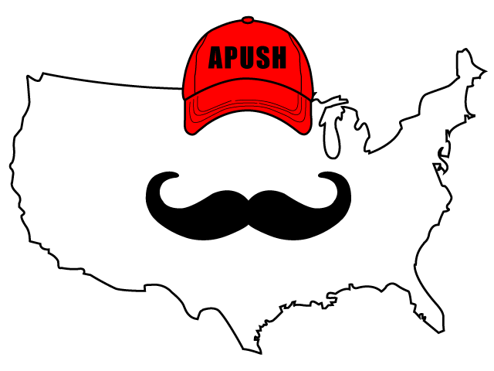
APUSH Review: Video #26: Antislavery Efforts And The Expansion Of Slavery (Key Concept 4.3, II, A-B)
Everything You Need To Know About Antislavery Efforts And The Expansion Of Slavery To Succeed In APUSH
www.APUSHReview.com

Slide 2

Expansion Of Slavery
Overcultivation of land due to cotton made many plantation owners look west of the Appalachians
  Deep South - “Cotton Belt” - MS, AL, LA
As these plantation owners moved west, so did the institution of slavery

Slide 3
Early Antislavery Efforts
Throughout most of early American history, abolitionists consisted of a small portion of the population
18h-century:
  Free blacks
  Slaves
  Quakers

Slide 4
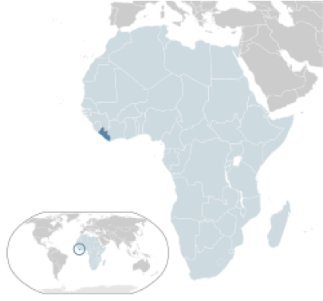
Colonization
Prior to 1830, many politicians supported colonization efforts of former slaves in Africa
  Henry Clay, John Marshall, Daniel Webster
1816 - American Colonization Society was founded
  Called for the gradual emancipation and movement of blacks to Africa
  Liberia was established on the West Coast of Africa

Slide 5
Antislavery Efforts
As the 19th century went on, antislavery efforts increased in the North
David Walker:
  Creator of An Appeal to the Colored Citizens of the World
  Critic of colonization
  Used the Bible and Declaration of Independence in his writings

Slide 6
Nat Turner
Led one of the largest slave rebellions in history (1831)
As with virtually all slave rebellions, slave codes became more strict afterwards

Slide 7
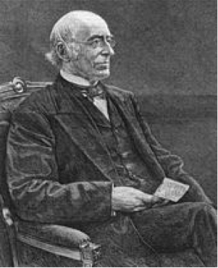
William Lloyd Garrison
Creator of The Liberator (1831 - 1865)
  Weekly newspaper calling for the immediate and uncompensated end to slavery
Against colonization
Criticized the Constitution because it was complicit with slavery

Slide 8
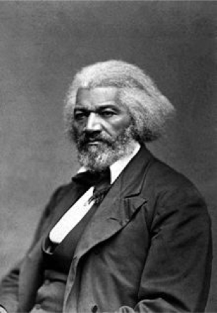
Frederick Douglass
Former slave from Maryland
Incredible orator, supporter of women’s rights, and staunch abolitionist
Creator of the North Star
4th of July Speech - “What, to the American slave, is your 4th of July?”

Slide 9
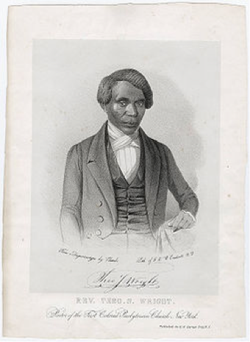
American Anti-Slavery Society (1833 - 1870)
250,000 members nationwide
Several African Americans served on the board of directors
  Theodore S. Wright - co-founder
    Attended Princeton Theological Seminary
    Conductor on the Underground RR
    Used religious arguments against slavery

Slide 10
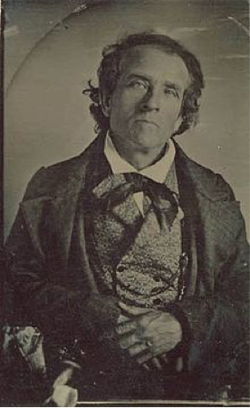
Theodore Weld
Minister that preached throughout the North about the evils of slavery
Argued slavery was a sin
  Instrumental in reshaping the movement away from gradual emancipation to immediate emancipation

Slide 11
Southern Views Of Slavery
Most Southerners did NOT own slaves
Southern was defended by Southern leaders and writers:
  George Fitzhugh and John C. Calhoun
Slavery was seen as a “positive good”

Slide 12
Quick Recap
Early abolitionists
Goals of the American Colonization Society
Goals and writings of:
  David Walker
  Nat Turner
  William Lloyd Garrison
  Frederick Douglass
  Theodore Wright
  Theodore Weld
Southern views of slavery

Slide 13
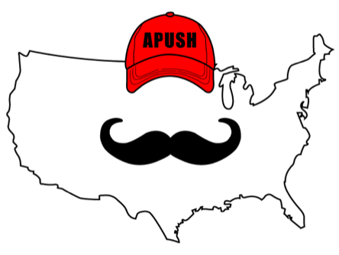
See You Back Here For Video #27: The Second Great Awakening
Thanks for watching
Best of luck!

