Slide 1
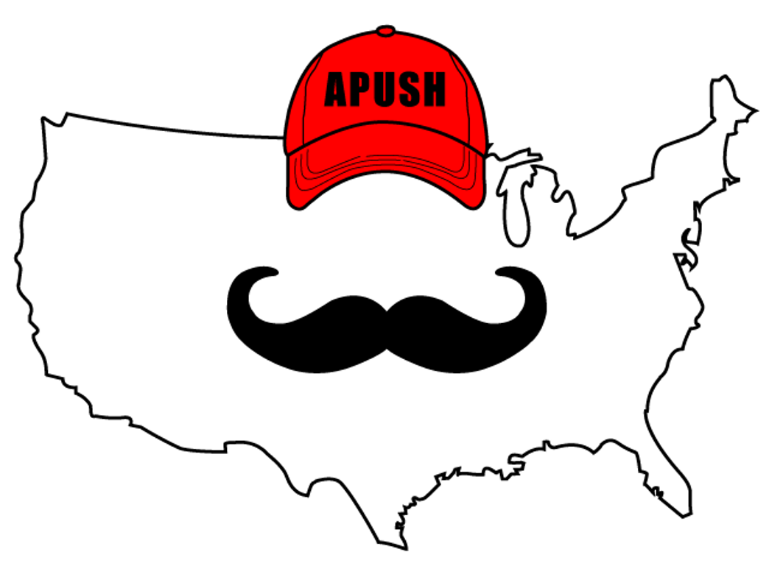
APUSH Review: Unit 1, Learning Objective A (Topic 1.1)
Explain the context for European encounters in the Americas from 1491 - 1607.

Slide 2
APUSH Test Tip
Contextualization is a significant skill you must understand to succeed in APUSH. Understanding the big picture of this time period is important for contextualization.

Slide 3
What Is Contextualization?
Big idea of what is going on BEFORE a time period
Think the Star Wars scroll in the movies
Gives background for what you’re about to watch
When writing essays, contextualization can go in the intro paragraph
3-4 sentences

Slide 4
Why Were These Dates (1491 - 1607) Chosen?
1491 is one year PRIOR to Columbus’ voyage
Native Americans were isolated from Europe PRIOR to Columbus
In 1607, England founded Jamestown
Most of this unit will focus on:
Native American life prior to Columbus
Spanish colonization of the Americas
Jamestown, Virginia
Christopher Columbus

Slide 5
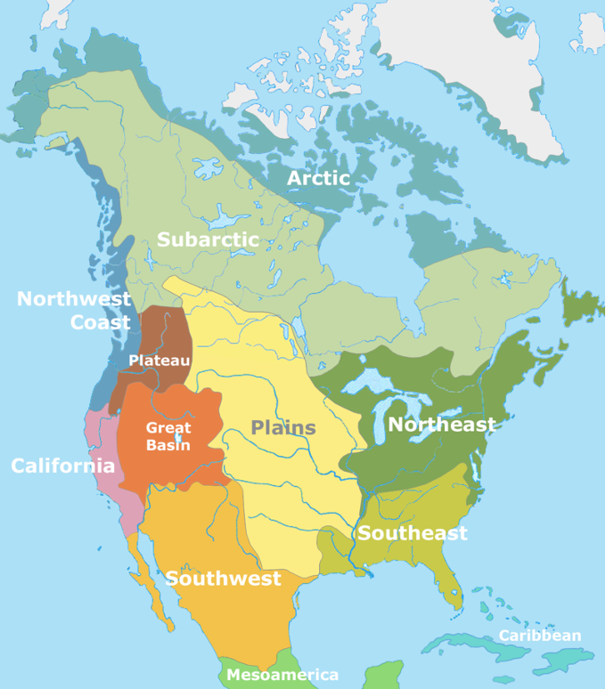
Native Americans Before 1492
Diverse societies that adapted to their environments
Hunting (Great Plains)
Farming (maize)
Irrigation systems

Slide 6
Columbian Exchange
Exchange of goods, ideas, people, crops, and diseases between the Americas, Europe, and Africa
Forever changed the life/society in the three continents

Slide 7
Impacts Of Contact On Europe
Population increase (potatoes, maize)
Development of mercantilism
Purpose of the colonies is to make $ for the mother country

Slide 8
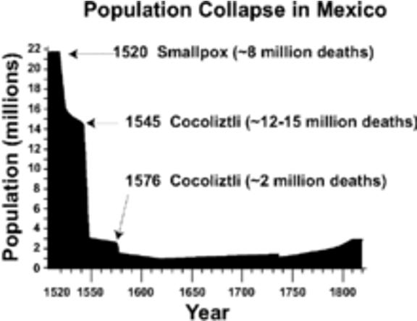
Impacts Of Contact On Native Americans
Population decreased drastically
Smallpox
Enslavement of Natives
Encomienda System

Slide 9
Impacts Of Contact On Africans
Atlantic Slave trade
Started by Spain and Portugal
Middle Passage:
Forced migration of Africans to the Americas
Chattel Slavery:
System in which enslaved individuals could be bought and sold at will; children would be enslaved as well

Slide 10
Differing Worldviews Between Natives And Europeans
Each group had different worldviews in regards to
Religion
Gender Roles
Land Use
Will be discussed in more detail in topic 1.6

Slide 11
Part II Document Questions
What were reasons for the drastic decline of Native American populations in Mexico, as shown in the image?

Slide 12
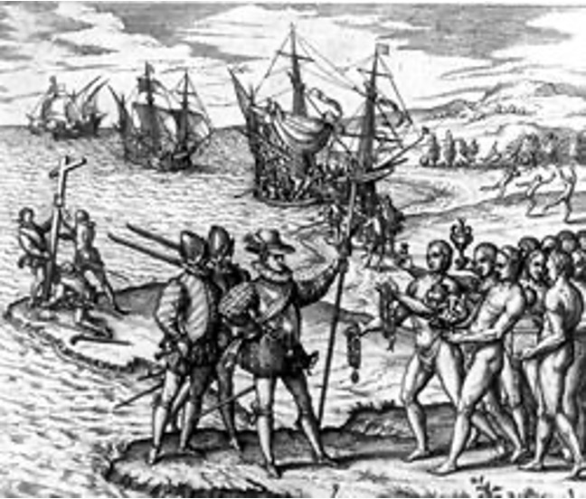
Part II Document Questions
What does the cross in the left side of the painting suggest about motives for exploration?

Slide 13
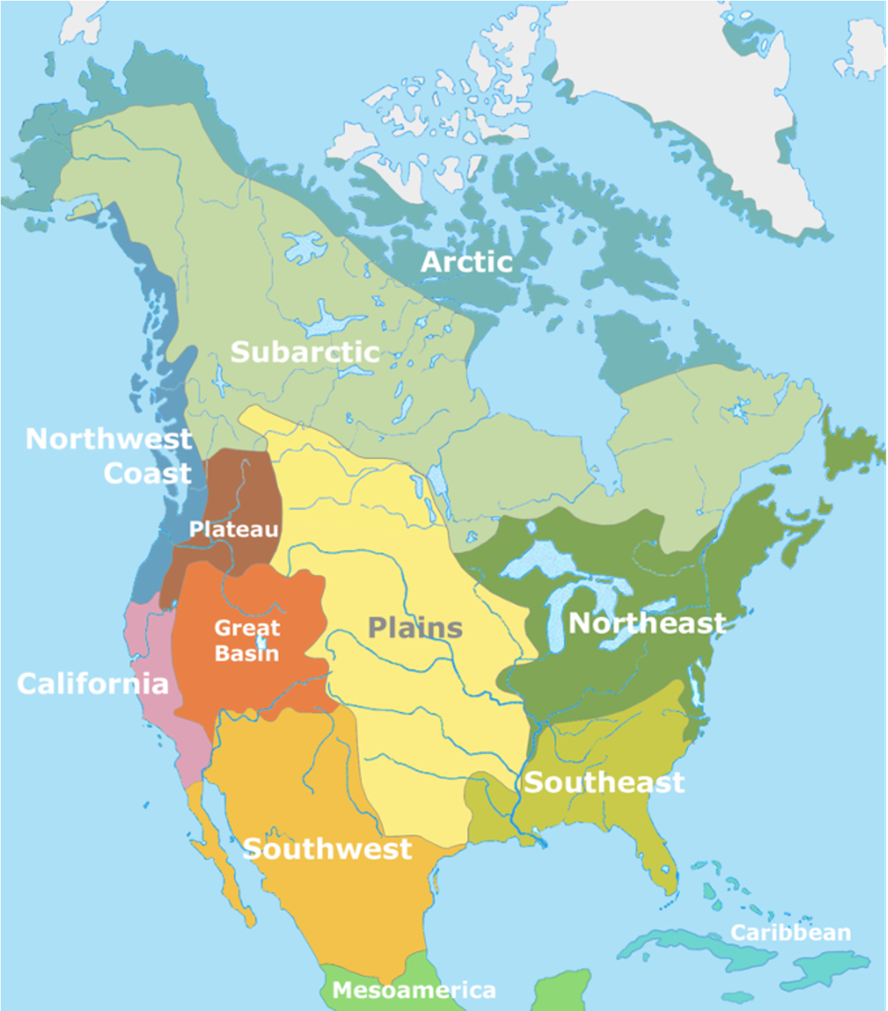
See You Next Time For Objective B (1.2)

