Slide 1
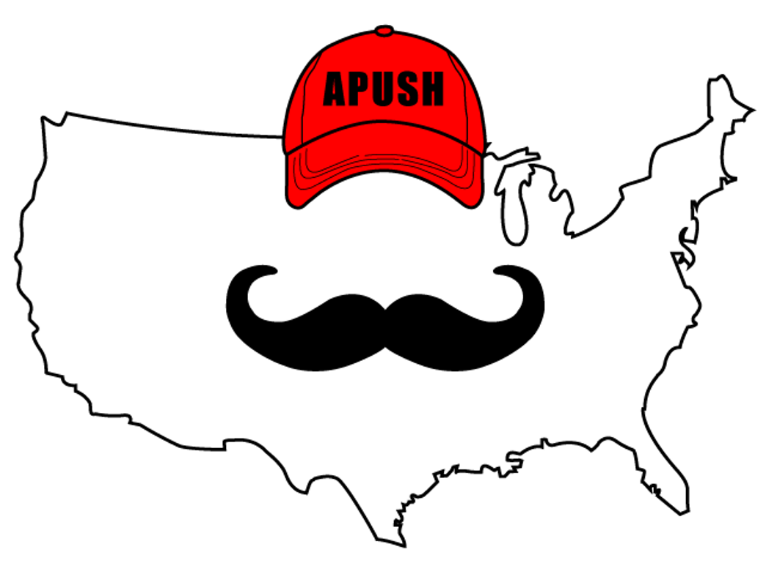
APUSH Review: Unit 1, Learning Objective B (Topic 1.2)
Explain how and why various native populations in the period before European contact interacted with the natural environment in North America.

Slide 2
APUSH Test Tip
If you encounter an essay topic on the Columbian Exchange or the impacts of European exploration on the Western Hemisphere, a brief description of this topic could count as your contextualization point in the essay.

Slide 3
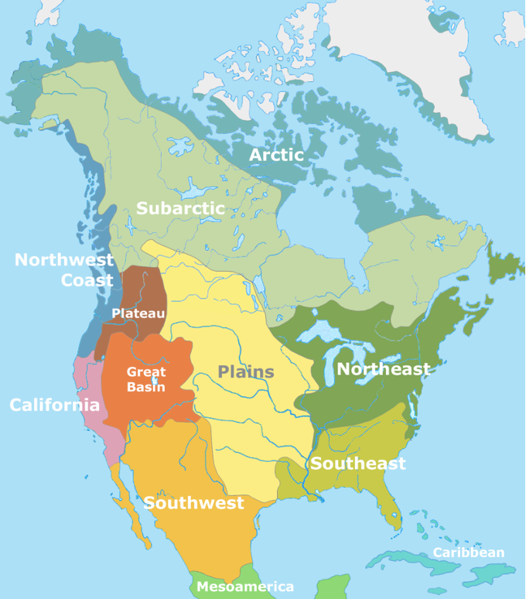
Must Know Regions Where Natives Lived
Mexico and the American Southwest
Great Plains and the Great Basin
Northeast, Mississippi River Valley, and Atlantic seaboard
Northwest and California

Slide 4
Mexico And The American Southwest
Focused heavily on maize (corn) cultivation
Led to permanent villages and settlements
Emergence of social classes
Pueblos developed irrigation systems

Slide 5
Great Plains And The Great Basin
What did the buffalo say to his son when he went away to college?
Bye son (Bison)
Central part of US
Natives adapted to the environment by:
Being mobile and hunting bison and sheep
Nomadic, no permanent settlements
Post European contact:
Horse and guns made hunting more efficient

Slide 6
Northeast, Mississippi River Valley, and Atlantic Seaboard
Focused on hunting and gathering and agriculture
Permanent villages developed
Cahokia (Near present-day St. Louis)
10,000 people in 1200 C.E.
Iroquois (present day New York)
Burned forests to hunt animals and grow crops
Villages built around maize

Slide 7
Northwest And California
Focused on hunting, gathering, and foraging
Nuts, fish, and hunt animals
Ocean resources helped support Native American populations

Slide 8
Part II
Complete Venn Diagram based on the following prompt:
“Compare and contrast the similarities and differences between Native Americans in the Great Plains and Great Basin with Native Americans in the Northeast.”

Slide 9
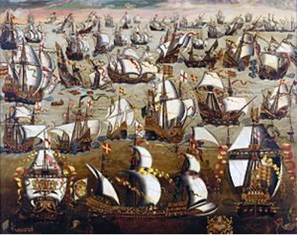
See You Next Time For Learning Objective C. (Topic 1.3)

