Slide 1
APUSH Review: Unit 1, Learning Objective C (Topic 1.3)
Explain the causes of exploration and conquest of the New World by various European nations.

Slide 2
APUSH Test Tip
Like the previous topic, information from this topic could count towards contextualization on an essay about impacts of European contact on the Americas. Discussing why Europeans were able to travel to the Americas would serve as a great example of contextualization.

Slide 3
Reasons For European Exploration And Conquest
Search for new sources of wealth
Economic and military competition
Desire to spread Christianity
Think 3 Gs - Gold, Glory, and God!

Slide 4
Search For New Sources Of Wealth
Europeans sought an overseas route to Asia
Markets to sell goods
Acquire gold and silver
Spain acquired gold and silver in the Americas
Other European nations searched for precious metals as well

Slide 5
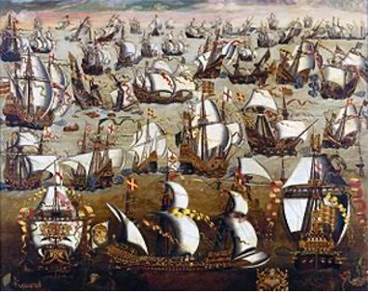
Economic And Military Competition
Spain and Portugal dominated early exploration
English defeat of the Spanish Armada (1588)
England emerged as a naval power
Spurred English exploration of the Americas

Slide 6
Desire To Spread Christianity
Spain sought to spread Catholicism to other parts of the world
Spain established Missions
Buildings throughout North and South America that converted Native Americans to Catholicism
Example of a Mission?
The Alamo!

Slide 7
Part II
Rank the reasons for exploration from most significant (1) to least significant (3). Explain why you chose (1) to be the most significant

