Slide 1
APUSH Review: Unit 1, Learning Objective D (Topic 1.4)
Explain causes of the Columbian Exchange and its effect on Europe and the Americas during the period after 1492

Slide 2
APUSH Test Tip
The Columbian Exchange might be the most important topic so far in the curriculum. This refers to the transfer of goods, people, ideas, food, and diseases between Africa, Europe, and the Americas. None of these regions were the same after this event. This is a great topic to appear on multiple-choice and short answer questions. Make sure you know the impact on each region

Slide 3
Causes Of The Columbian Exchange
New maritime technology:
When the sextant (determines latitude) and caravel (faster ship) were invented, this led to further exploration
Formation of joint-stock companies:
People would pool their money together (invest) and share in profits and losses of explorations
Precursor to corporations later

Slide 4
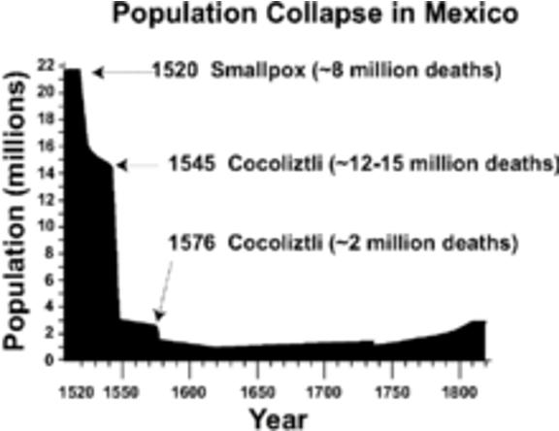
Effects Of Columbian Exchange On The Americas
Diseases (smallpox) devastated Native American populations
Some areas saw population decline by 90%
Introduction of new animals
Horse - transformed life for Natives living on Great Plains and Great Basin
Introduction of new crops:
Rice and sugar - grown in the South and Caribbean -> arduous labor

Slide 5
Effects Of Columbian Exchange On Europe
Introduction of new crops:
Potato and maize (corn) led to a population growth in Europe
Influx of precious metals (gold and silver)
Europe shifted from feudalism to capitalism

Slide 6
Part II - Short Answer Question
Briefly explain one impact of the Columbian Exchange on the Americas
Briefly explain one additional impact of the Columbian Exchange on the Americas
Briefly explain one impact of the Columbian Exchange on Europe

Slide 7
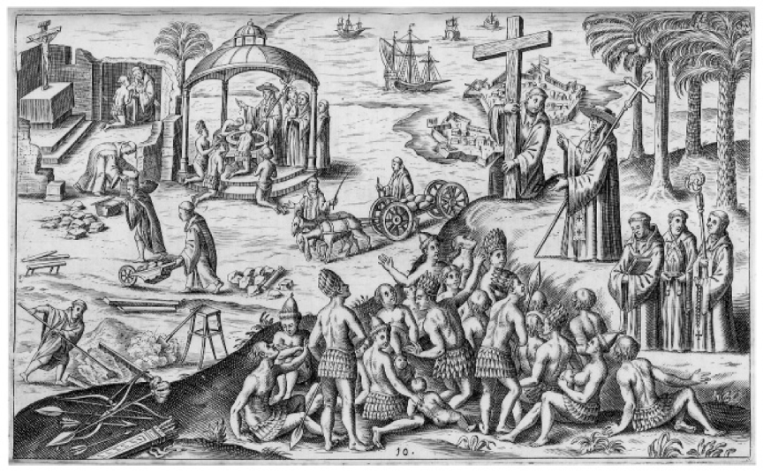
See You Next Time For Objective E (1.5)
Spanish Colonization Illustration from 1621

